Slide 1
約書亞記 Joshua 3: 1-8
约书亚清早起来，和以色列众人都离开什亭，来到约旦河，就住在那里，等候过河。2过了三天，官长走遍营中，3吩咐百姓说，你们看见耶和华你们神的约柜，又见祭司利未人抬着，就要离开所住的地方，跟着约柜去。4只是你们和约柜相离要量二千肘，不可与约柜相近，使你们知道所当走的路，因为这条路你们向来没有走过。5约书亚吩咐百姓说，你们要自洁，因为明天耶和华必在你们中间行奇事。6约书亚又吩咐祭司说，你们抬起约柜，在百姓前头过去。于是他们抬起约柜，在百姓前头走。7耶和华对约书亚说，从今日起，我必使你在以色列众人眼前尊大，使他们知道我怎样与摩西同在，也必照样与你同在。8你要吩咐抬约柜的祭司说，你们到了约旦河的水边上，就要在约旦河水里站住。

Slide 2
Joshua 3: 1-8 Then Joshua rose early in the morning; and they set out from Acacia Grove and came to the Jordan, he and all the children of Israel, and lodged there before they crossed over. ² So it was, after three days, that the officers went through the camp; ³ and they commanded the people, saying, “When you see the ark of the covenant of the Lord your God, and the priests, the Levites, bearing it, then you shall set out from your place and go after it. ⁴ Yet there shall be a space between you and it, about two thousand cubits by measure. Do not come near it, that you may know the way by which you must go, for you have not passed this way before.”⁵ And Joshua said to the people, “Sanctify yourselves, for tomorrow the Lord will do wonders among you.” ⁶ Then Joshua spoke to the priests, saying, “Take up the ark of the covenant and cross over before the people.”So they took up the ark of the covenant and went before the people.⁷ And the Lord said to Joshua, “This day I will begin to exalt you in the sight of all Israel, that they may know that, as I was with Moses, so I will be with you. ⁸ You shall command the priests who bear the ark of the covenant, saying, ‘When you have come to the edge of the water of the Jordan, you shall stand in the Jordan.’ ” (NKJV)

Slide 3
跨過生命中的約旦河 -進入應許之地（三） Crossing the Jordan in Life -Entering the Promised Land (III)
約書亞記 三-四章 Joshua 3-4
讲员：冯伟牧师
Preacher: Rev. Wei Feng

Slide 4
前言Introduction:
四十年前过了红海，现在又要过约旦河？
Crossed the Red Sea forty years ago, now Jordan River again?

Slide 5
I. 过红海与过约旦河的异同– Similarities and differences between crossing Red Sea and Jordan River
- 相同：神迹! Similarity: Miracle!
- 不同 Differences：
1. 敌人在哪里 Where are the enemies
2. 约柜和祭司 The Ark and the priests
3. 杖分红海与脚入急流 Moses’ staff vs. Priests’ feet
4. 从埃及到旷野与从旷野到迦南 From Egypt to the desert vs. from the desert to Canaan

Slide 6
I. 过红海与过约旦河的异同– Similarities and differences between crossing Red Sea and Jordan River
过红海预表受洗 Crossing Red Sea symbolizes baptism
林前10：1-2 弟兄们，我不愿意你们不晓得，我们的祖宗从前都在云下，都从海中经过。2都在云里海里受洗归了摩西。
1 Cor. 10: 1-2 Moreover, brethren, I do not want you to be unaware that all our fathers were under the cloud, all passed through the sea, ² all were baptized into Moses in the cloud and in the sea

Slide 7
I. 过红海与过约旦河的异同– Similarities and differences between crossing Red Sea and Jordan River
过约旦河象征基督徒进入神的应许之地，丰盛生命。
Crossing Jordan symbolizes Christians entering God’s promised land – Abundant Life.
过红海一次 Crossing Red Sea Once
过约旦河可能多次 Crossing Jordan Might be Multiple Times

Slide 8
I. 过红海与过约旦河的异同– Similarities and differences between crossing Red Sea and Jordan River
来4：5-11 又有一处说，他们断不可进入我的安息。6既有必进安息的人，那先前听见福音的，因为不信从，不得进去。7所以过了多年，就在大卫的书上，又限定一日，如以上所引的说，你们今日若听他的话，就不可硬着心。8若是约书亚已叫他们享了安息，后来神就不再提别的日子了9这样看来，必另有一安息日的安息，为神的子民存留。10因为那进入安息的，乃是歇了自己的工，正如神歇了他的工一样。11所以我们务必竭力进入那安息，免得有人学那不信从的样子跌倒了.

Slide 9
I. 过红海与过约旦河的异同– Similarities and differences between crossing Red Sea and Jordan River
Hebrews 4：5-11 and again in this place: “They shall not enter My rest.”⁶ Since therefore it remains that some must enter it, and those to whom it was first preached did not enter because of disobedience, ⁷ again He designates a certain day, saying in David, “Today,” after such a long time, as it has been said:“Today, if you will hear His voice, Do not harden your hearts.”⁸ For if Joshua had given them rest, then He would not afterward have spoken of another day. ⁹ There remains therefore a rest for the people of God. ¹⁰ For he who has entered His rest has himself also ceased from his works as God did from ¹¹ Let us therefore be diligent to enter that rest, lest anyone fall according to the same example of disobedience.

Slide 10
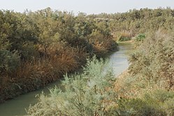
II. 约旦河– The Jordan River

Slide 11
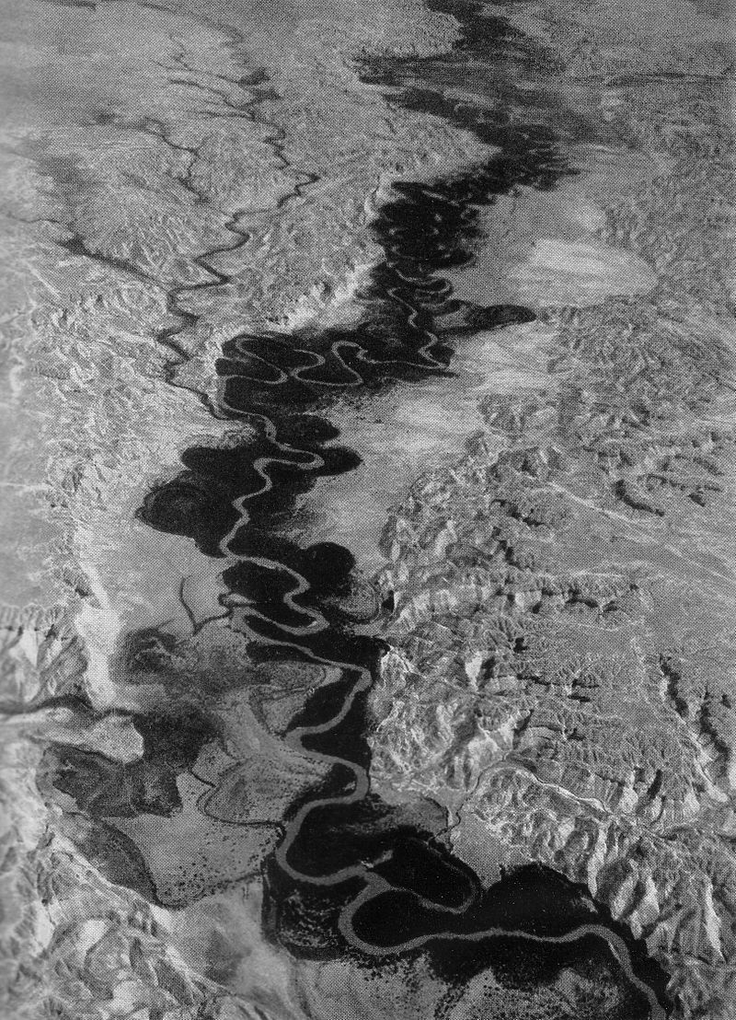
II. 约旦河– The Jordan River

Slide 12
II. 约旦河– The Jordan River
- 不是偶像 Not An Idol
- 不是“母亲河”Not “Mother River”
- 巴力假神的保护 Protection of Baal
- 神子民的拦阻 Barrier to God’s Children
- 被神子民征服 Overcome by God’s Children
- 约旦河中受洗 Baptism in Jordan River

Slide 13
III. 过约旦河– Crossing The Jordan River
更宽 Wider
更深 Deeper
更快 Faster
更浑 Dirtier

Slide 14
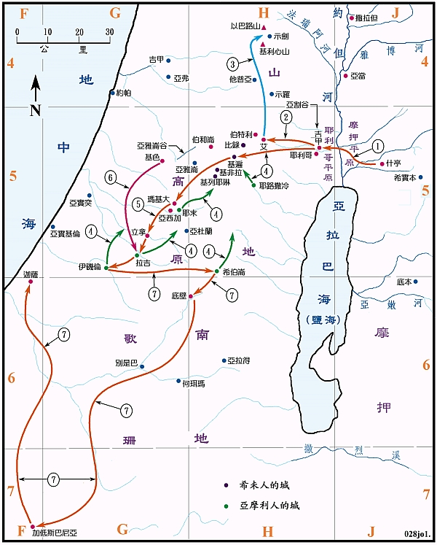

Slide 15
III. 过约旦河– Crossing The Jordan River
耶利哥 vs. 亚当城
Jericho vs. Adam
距离 Distance: 27 km (17 miles)
流速 Speed: 3 m/s (6.7 miles/h) （?）

Slide 16
III. 过约旦河– Crossing The Jordan River
約書亞吩咐百姓說：『你們要自潔，因為明天耶和華必在你們中間行奇事。- v5 And Joshua said to the people, “Sanctify^{[c]} yourselves, for tomorrow the Lord will do wonders among you.” – v5
祭司的信心 Faith of the Priests

Slide 17
IV. 生命中的约旦河– Jordan in Life

Slide 18
結論与应用 Conclusion and Response:
1. 你生命中的约旦河是什么，如何胜过？- What is the Jordan in your life? How to overcome?
2. 默想并背诵希伯来书 11:6 “人非有信就不能得神的喜悦。因为到神面前来的人，必须信有神，且信他赏赐那寻求他的人。”
Meditate and Memorize Hebrews 11: 6 “But without faith it is impossible to please Him, for he who comes to God must believe that He is, and that He is a rewarder of those who diligently seek Him” (NKJV)

