Slide 1
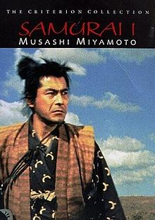
宮本武藏
Miyamoto Musashi

Slide 2
不潔淨了！不潔淨了！ Unclean! Unclean!
黄力夫弟兄
Brother Leaf
北卡華人福音基督教会
CCMC

Slide 3
利 13：45
身上有長大痲瘋災病的，他的衣服要撕裂，也要蓬頭散髮，蒙著上唇，喊叫說：『不潔淨了！不潔淨了！』
Lev 13:45
Anyone with such a defiling disease must wear torn clothes, let their hair be unkempt, cover the lower part of their face and cry out, “Unclean! Unclean!”

Slide 4
潔净與不潔净 Clean & Unclean
利未記11-15章記載了什麽是潔净，什麽是不潔净。
長大痲瘋的當然不潔净。
頭上長癤子掉頭髮的也不潔净。
利 13：41“他頂前若掉了頭髮，他不過是頂門禿，還是潔淨。” Lev 13:41 “If he has lost his hair from the front of his scalp and has a bald forehead, he is clean.”
有許多的食物是不潔净的。
神爲什麽這麽介意潔净與不潔净？

Slide 5
聖潔的神 Holy God
利 11：45“我是把你們從埃及地領出來的耶和華，要作你們的神；所以你們要聖潔，因為我是聖潔的。” Lev 11:45 “I am the Lord, who brought you up out of Egypt to be your God; therefore be holy, because I am holy.”
飲食的禁戒，生活習慣的約束，使神的選民分別為聖。
違反禁戒的，就是不潔净。

Slide 6
如何潔净？How to be Clean?
立刻戒除不潔净的食物或生活習慣。
還有甬長的程序。
更重要的是祭司的角色。
利 14：2“長大痲瘋得潔淨的日子，其例乃是這樣：要帶他去見祭司。” Lev 14:2 “These are the regulations for any diseased person at the time of their ceremonial cleansing, when they are brought to the priest.”
祭司有甬長的禮儀程序要做，一共8天。

Slide 7
利 14：10“第八天，他要取兩隻沒有殘疾的公羊羔和一隻沒有殘疾、一歲的母羊羔，又要把調油的細麵伊法十分之三為素祭，並油一羅革，一同取來。” Lev 14:10 “On the eighth day they must bring two male lambs and one ewe lamb a year old, each without defect, along with three-tenths of an ephah of the finest flour mixed with olive oil for a grain offering, and one log of oil.”
利 14：20“把燔祭和素祭獻在壇上，為他贖罪，他就潔淨了。” Lev 14:20 “and offer it (burnt offering) on the altar, together with the grain offering, and make atonement for them, and they will be clean.”
要殺三只沒有殘疾的羊羔獻燔祭。

Slide 8
獻祭的意義 Meaning of Sacrificial Offering
來 9：20“這血就是神與你們立約的憑據。” Heb 9:20 “He said, “This is the blood of the covenant, which God has commanded you to keep.”
來 9：22“按著律法，凡物差不多都是用血潔淨的；若不流血，罪就不得赦免了。” Heb 9:22 “In fact, the law requires that nearly everything be cleansed with blood, and without the shedding of blood there is no forgiveness.”
來 10：3-4“但這些祭物是叫人每年想起罪來；因為公牛和山羊的血，斷不能除罪。” Heb 10:3-4 “But those sacrifices are an annual reminder of sins. It is impossible for the blood of bulls and goats to take away sins.”
獻祭得潔净，得以除罪，預表耶穌。

Slide 9
新約的大祭司 High Priest in NT
約一 2：2“他為我們的罪作了挽回祭，不是單為我們的罪，也是為普天下人的罪。” 1 Jn 2:2 “He is the atoning sacrifice for our sins, and not only for ours but also for the sins of the whole world.”
是沒有殘疾的羔羊。
耶穌全然無罪，連原罪也沒有。

Slide 10
我們都不潔净 We are All Unclean
罪的三个層次﹕
1。 法律上的罪 - 以證據为依據
2。 道德上的罪 - 以良心为依據
3。 神眼中的罪 - 以聖經为依據

Slide 11
罪 SIN
羅 3:23“世人都犯了罪，虧缺了神的榮耀。” Rom 3:23 “for all have sinned and fall short of the glory of God.”
不光看行為，也看内心; 不光看結果，也看動機。
不該做（想）的，做（想）了; 該做（想）的，没做（想）。
羅 3:10“没有義人，連一個也没有。” Rom 3:10 “As it is written, ‘There is no one righteous, not even one.”

Slide 12
各各他的至聖所 Holy of Holies of Golgotha
來 9：3“第二幔子後又有一層帳幕，叫作至聖所。” Heb 9:3 “Behind the second curtain was a room called the Most Holy Place…”
來 9：7“至於第二層帳幕，惟有大祭司一年一次獨自進去，沒有不帶著血為自己和百姓的過錯獻上。” Heb 9:7 “But only the high priest entered the inner room, and that only once a year, and never without blood, which he offered for himself and for the sins the people had committed in ignorance.”

Slide 13
各各他的至聖所 Holy of Holies of Golgotha
來 9：11-12“但現在基督已經來到，作了將來美事的大祭司，經過那更大更全備的帳幕，不是人手所造、也不是屬乎這世界的；並且不用山羊和牛犢的血，乃用自己的血，只一次進入聖所，成了永遠贖罪的事。” Heb 9:11-12 “But when Christ came as high priest of the good things that are now already here, he went through the greater and more perfect tabernacle that is not made with human hands, that is to say, is not a part of this creation. He did not enter by means of the blood of goats and calves; but he entered the Most Holy Place once for all by his own blood, thus obtaining eternal redemption.”

Slide 14
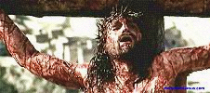
大祭司的禱告 Prayer of the High Priest
當下耶穌說：「父啊！赦免他們；因為他們所做的，他們不曉得。」 Jesus said, “Father, forgive them, for they do not know what they are doing.”
Lk 路加福音 23: 34

Slide 15
十字架 Crucifix
最殘酷的死刑。
詩篇22篇，大衛寫的。
我如水被倒出來；我的骨頭都脫了節；我心在我裡面如蠟鎔化。 I am poured out like water, and all my bones are out of joint. My heart has turned to wax; it has melted within me.
我的精力枯乾，如同瓦片；我的舌頭貼在我牙床上。你將我安置在死地的塵土中。 My mouth is dried up like potsherd, and my tongue sticks to the roof of my mouth; you lay me in the dust of death.

Slide 16
犬類圍著我，惡黨環繞我；他們扎了我的手，我的腳。 Dogs surround me, a pack of villains encircles me; they pierce my hands and my feet.
我的骨頭，我都能數過；他們瞪著眼看我。 All my bones are on display; people stare and gloat over me.
他們分我的外衣，為我的裡衣拈鬮。 They divide my clothes among them and cast lots for my garment.
全部都應驗在耶穌身上。

Slide 17
耶穌為我們付了地獄刑罰的代價﹗ Jesus Paid the Price of Hell On Our Behalf
馬 可 福 音 15﹕34 “申 初 的 時 候 、 耶 穌 大 聲 喊 著 說 、 以 羅 伊 、 以 羅 伊 、 拉 馬 撒 巴 各 大 尼 。 翻 出 來 、 就 是 我 的 神 、 我 的 神 、 為 甚 麽 離 棄 我 。” Mk 15:34 “And at three in the afternoon Jesus cried out in a loud voice, ‘Eloi, Eloi, lema sabachthani?’ (which means “My God, my God, why have you forsaken me?”).”

Slide 18
宮本武藏
Miyamoto Musashi

Slide 19
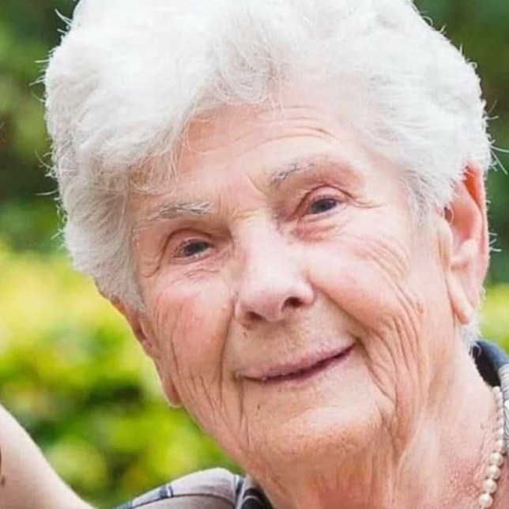
Suzanne Hoylaerts, 90

Slide 20
耶穌往耶路撒冷去，經過撒瑪利亞和加利利。 進入一個村子，有十個長大痲瘋的，迎面而來，遠遠的站著， 高聲說：「耶穌，夫子，可憐我們吧！」 耶穌看見，就對他們說：「你們去把身體給祭司察看。」他們去的時候就潔淨了。 內中有一個見自己已經好了，就回來大聲歸榮耀與神， 又俯伏在耶穌腳前感謝他；這人是撒瑪利亞人。 耶穌說：「潔淨了的不是十個人嗎？那九個在那裡呢？ 除了這外族人，再沒有別人回來歸榮耀與神嗎？」 就對那人說：「起來，走吧！你的信救了你了。」 路 17：11-19

Slide 21
Now on his way to Jerusalem, Jesus traveled along the border between Samaria and Galilee. As he was going into a village, ten men who had leprosy met him. They stood at a distance and called out in a loud voice, “Jesus, Master, have pity on us!” When he saw them, he said, “Go, show yourselves to the priests.” And as they went, they were cleansed. One of them, when he saw he was healed, came back, praising God in a loud voice. He threw himself at Jesus’ feet and thanked him—and he was a Samaritan. Jesus asked, “Were not all ten cleansed? Where are the other nine? Has no one returned to give praise to God except this foreigner?” Then he said to him, “Rise and go; your faith has made you well.”
Lk 17:11-19

Slide 22
你的信救了你了 Your Faith Has Made You Well
十個長大痲瘋的。
內中有一個見自己已經好了，就回來大聲歸榮耀與神，又俯伏在耶穌腳前感謝他；這人是撒瑪利亞人。 One of them, when he saw he was healed, came back, praising God in a loud voice. He threw himself at Jesus’ feet and thanked him—and he was a Samaritan.
起來，走吧！你的信救了你了。 Rise and go; your faith has made you well.
你願意在主面前，說：不潔净了！
求主醫治拯救。

Slide 23
儅您願意今天決定接受主耶穌基督作救主和生命的主，請用Zoom舉手向神表明。
When you decide to receive Jesus Christ as Savior and Lord, please use the “Raise Hand” function
in Zoom to make the
declaration to God.

