Slide 1
Series: Encounters with God (OT)
Jonah 拿 4:1-11
Different and Same,
在神裡，
Under God
既不相同又相同

Slide 2
The Chef’s Menu

Slide 3
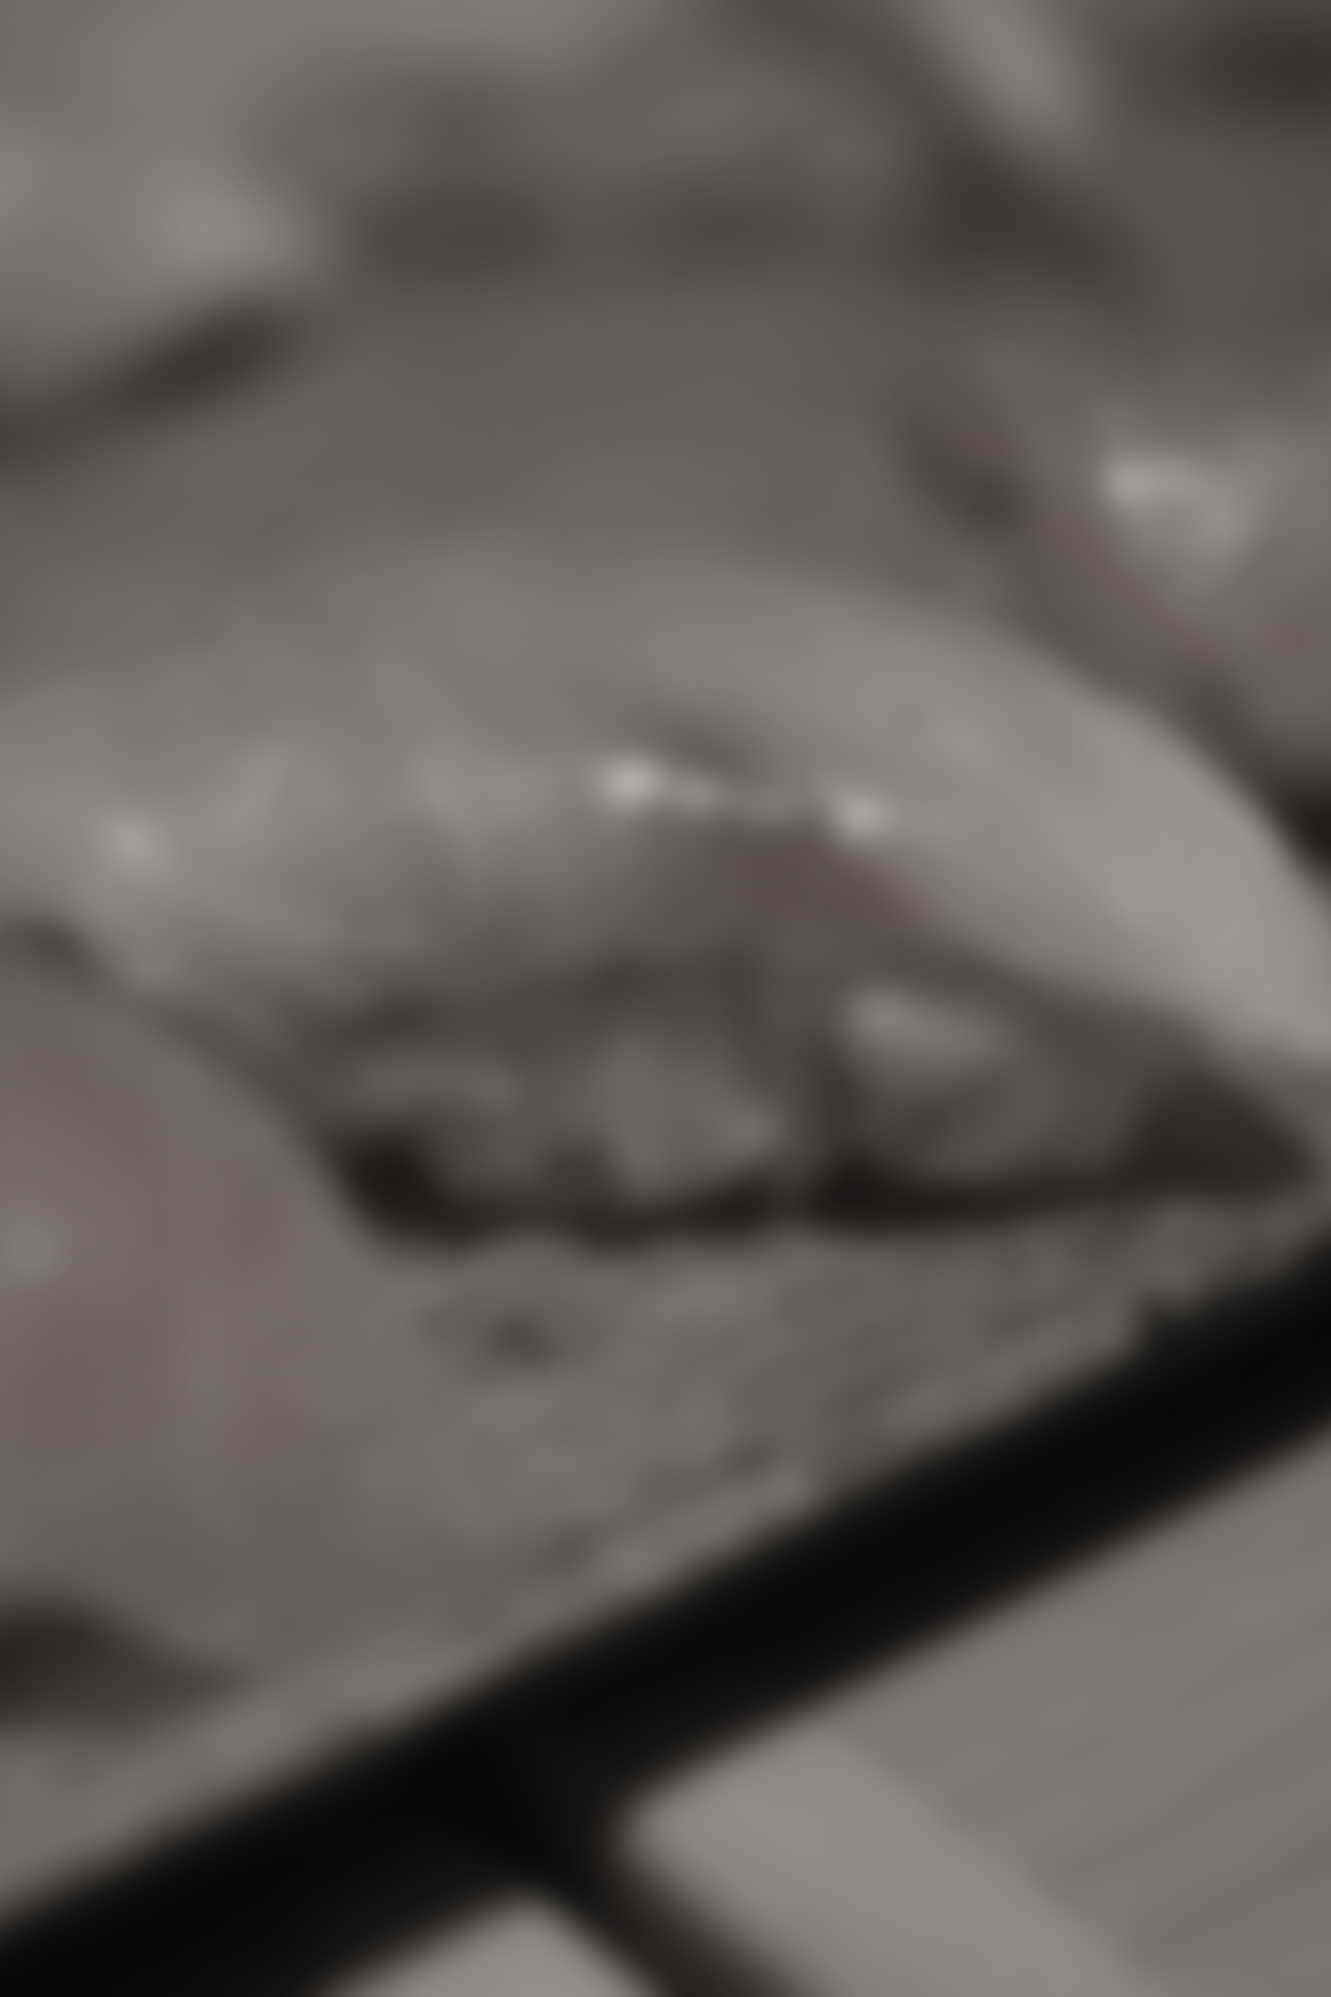
Omakase

Slide 4
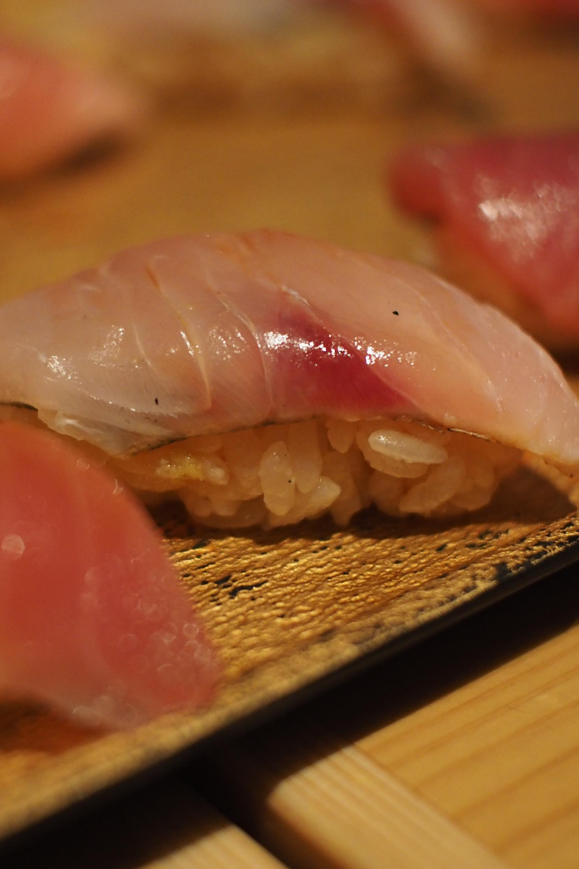
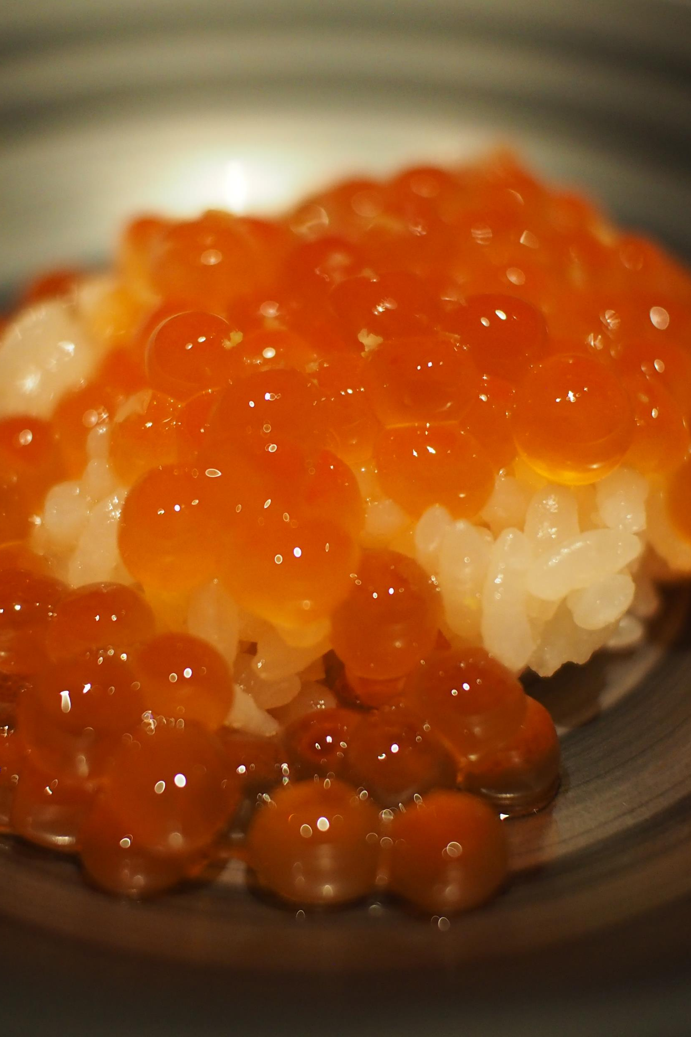
Omakase

Slide 5
The Chef’s Menu
Will we have the humility & submission to say, “Of course, Lord, omakase!”?

Slide 6
Jonah 拿 4:1-11

Slide 7
Jonah 拿 4
10 But the Lord said, “You have been concerned about this plant, though you did not tend it or make it grow. It sprang up overnight and died overnight. 11 And should I not have concern for the great city of Nineveh, in which there are more than a hundred and twenty thousand people who cannot tell their right hand from their left—and also many animals?”

Slide 8
Jonah 拿 4
10 耶 和 華 說 ： 這 蓖 麻 ， 不 是 你 栽 種 的 ， 也 不 是 你 培 養 的 ； 一 夜 發 生 ， 一 夜 乾 死 ， 你 尚 且 愛 惜 ；11 我 豈 能 不 愛 惜 尼 尼 微 這 大 城 呢 ， 其 中 不 能 分 辨 左 手 右 手 的 有 十 二 萬 多 人 ， 並 有 許 多 牲 畜 ？

Slide 9
The God-centering message of Jonah 4
God entreats us, the rebellious, with mercy first.
上帝先是以憐憫來對待我們這叛逆的人。

Slide 10
The Prophet’s (Self) Obsession

Slide 11
Jonah 拿 3
10 When God saw what they (Ninevites) did and how they turned from their evil ways, he relented and did not bring on them the destruction he had threatened.
10 於 是 神 察 看 他 們 （尼尼微人）的 行 為 ， 見 他 們 離 開 惡 道 ， 他 就 後 悔 起了憐恤， 不 把 所 說 的 災 禍 降 與 他 們 了 。

Slide 12
The Prophet’s (Self) Obsession
Just as the wickedness of Nineveh has come up to the LORD, so the “wickedness” of God’s mercy has come up to prophet Jonah.

Slide 13
The Prophet’s (Self) Obsession
Somehow, Jonah sees himself as having the rights to:
1/ Be excused for his own rebellion against God
2/ Accuse another for their rebellion against God

Slide 14
Jonah 拿 4
2 He prayed to the LORD, “Isn’t this what I said, LORD, when I was still at home? That is what I tried to forestall by fleeing to Tarshish. I knew that… .”
2 就 禱 告 耶 和 華 說 ： 耶 和 華 啊 ， 我 在 本 國 的 時 候 ， 豈 不 是 這 樣 說 嗎 ？ 我 知 道 …

Slide 15
The Prophet’s (Self) Obsession
Prophet Jonah’s theology did not lead him to fear God;
instead, it led him to fear God doing saving works against Jonah’s own wishes.

Slide 16
The Prophet’s (Self) Obsession
vv. 2-4 “I//my/me” x 6 = Prophet Jonah (unwittingly?) reveals his self obsession in his tirade against God
< > Prophet Jonah reveals who truly rules/ lords over his soul: Himself.

Slide 17
The Prophet’s (Self) Obsession
In our Self Obsession,
we will always think God exists to make our lives more pleasurable; we will always think that God ought to make our lives the way we want things to be.

Slide 18
Jonah 拿 2
8 Those who cling to worthless idols turn away from God’s love for them.
8 那 信 奉 虛 無 之 神 的 人 ， 離 棄 憐 愛 他 們 的 主 。

Slide 19
The LORD God’s Question

Slide 20
The LORD God’s Question
“4, 9 Is it right…?” =
1/ An invitation to consider the truth of the matter
2/ An exposure of whatever idolatrous treasure prophet Jonah is protecting

Slide 21
The LORD God’s Question
Under God, the Jews and the Gentiles i.e. all of humanity is first and foremost the same: Sinners in need of God’s mercy.

Slide 22
People of Mercy First –
! Or ?

Slide 23
Mt 太 6
14 For if you forgive other people when they sin against you, your heavenly Father will also forgive you. 15 But if you do not forgive others their sins, your Father will not forgive your sins.
14 你 們 饒 恕 人 的 過 犯 ， 你 們 的 天 父 也 必 饒 恕 你 們 的 過 犯 ；15 你 們 不 饒 恕 人 的 過 犯 ， 你 們 的 天 父 也 必 不 饒 恕 你 們 的 過 犯 。

Slide 24
People of Mercy First - ! Or ?
More often than not, it will be in the face of a great personal displeasure that we will know if we are people of mercy first or not.

Slide 25
People of Mercy First - ! Or ?
Is our new self in Jesus maturing such that the natural response when facing someone we do not favor or something we do not enjoy is to extend mercy and to be thankful for mercy on us?

Slide 26
Jonah 拿 4
11 And should I not have concern for the great city of Nineveh, in which there are more than a hundred and twenty thousand people who cannot tell their right hand from their left—and also many animals?”
11 我 豈 能 不 愛 惜 尼 尼 微 這 大 城 呢 ， 其 中 不 能 分 辨 左 手 右 手 的 有 十 二 萬 多 人 ， 並 有 許 多 牲 畜 ？

Slide 27
Lk 路 6
27 But to you who are listening I say: Love your enemies, do good to those who hate you, 28 bless those who curse you, pray for those who mistreat you.
27 只 是 我 告 訴 你 們 這 聽 道 的 人 ， 你 們 的 仇 敵 ， 要 愛 他 ！ 恨 你 們 的 ， 要 待 他 好 ！28 咒 詛 你 們 的 ， 要 為 他 祝 福 ！ 凌 辱 你 們 的 ， 要 為 他 禱 告 ！

Slide 28
Selah:
- Consider our sinfulness; ask God not only for forgiveness but the true belief that we are as deserving of God’s wrath as those we consider more sinful.
- Consider the mercy of our God; praise Him for entreating us with mercy first, with the Cross of Christ as the ultimate display of the mercy toward us.

Slide 29
Prayer
Dear Abba, by Your zeal, by the zeal of our Lord Jesus Christ, sanctify us more and more as mercy first people. Help us to give thanks, for by Your mercy, You have given us Jesus. And in him, we are made strong, we are made rich. By the name of Jesus who shows us mercy, we pray and give thanks for all the good You have done, amen.

