Slide 1
Series: Encounters with God (OT)
Isaiah 賽 6:1-13
Holy God,
聖潔的神，
Send Me
差遣我

Slide 2
Into the Highlands

Slide 3
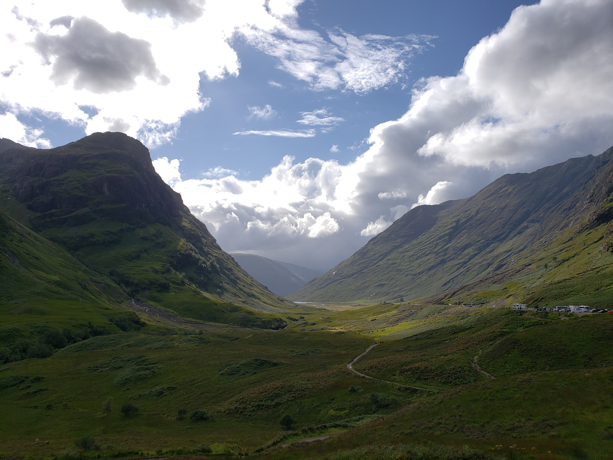

Slide 4
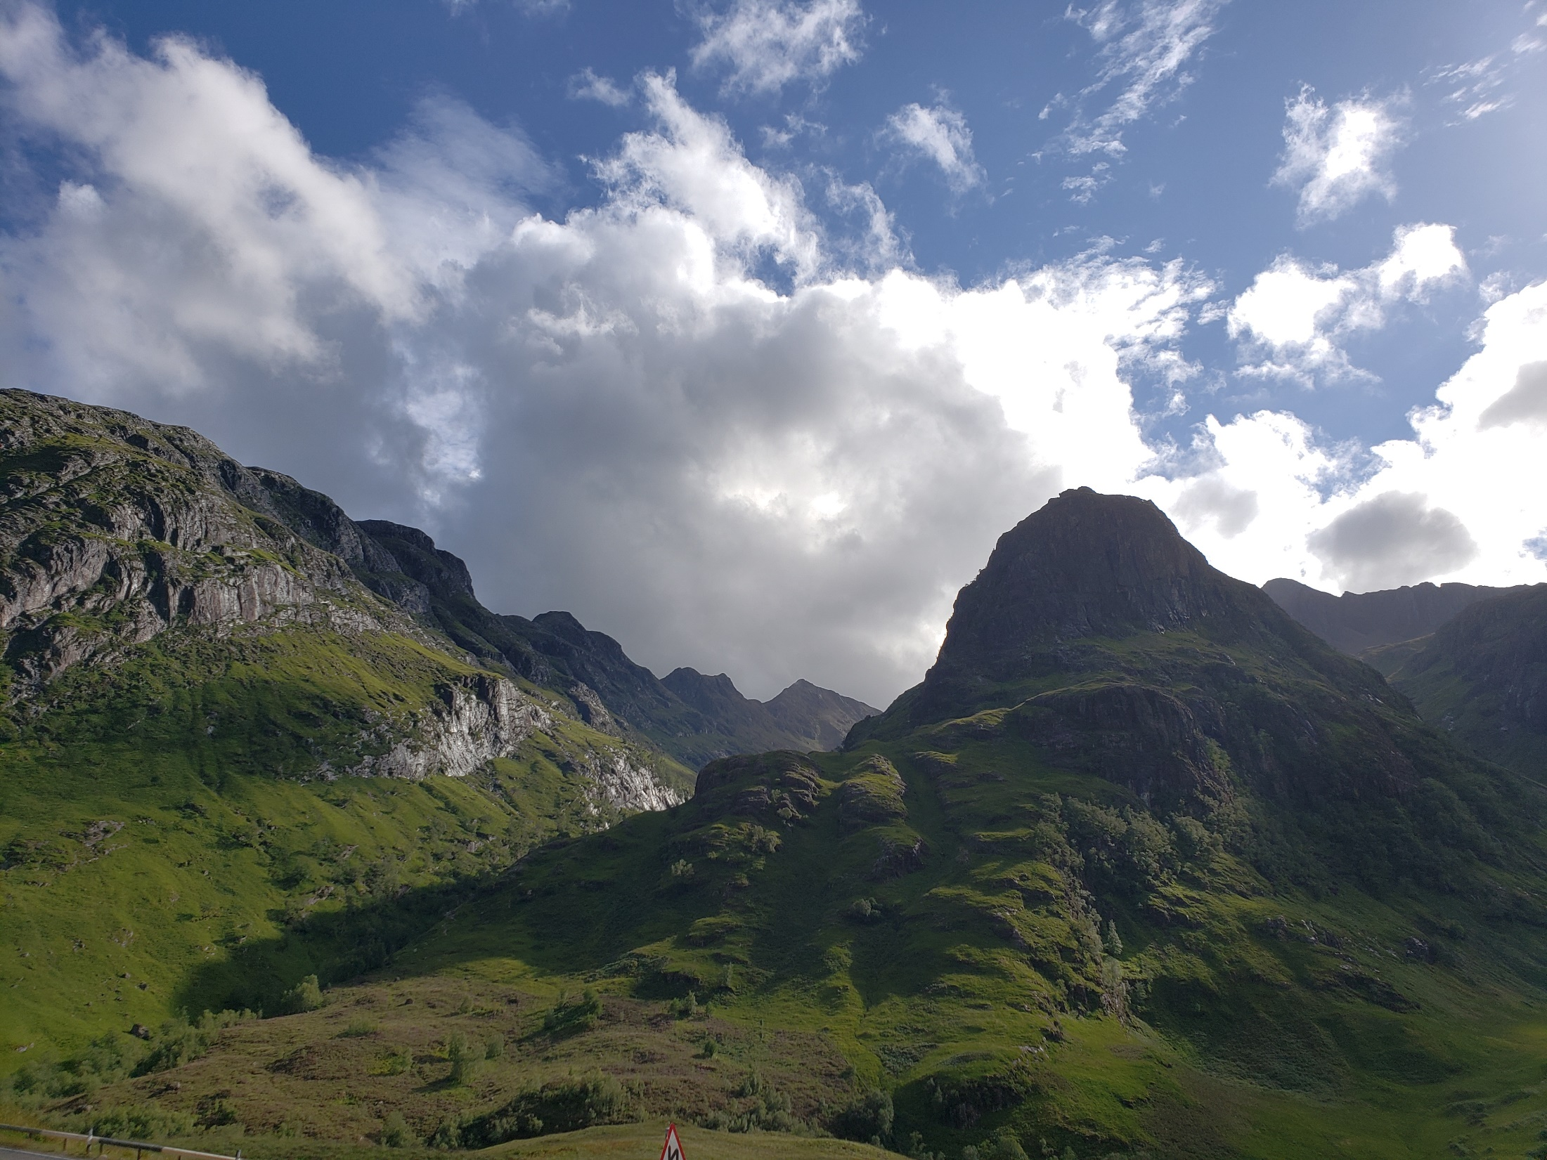

Slide 5
Into the Highlands
When we know God to be absolutely, utterly holy, we too, like Isaiah, will say to God, “Here I am. Send me.”

Slide 6
Isa 賽 6:1-7

Slide 7
Isa 賽 6
1 In the year that King Uzziah died, I saw the Lord, high and exalted, seated on a throne; and the train of his robe filled the temple. 2 Above him were seraphim, each with six wings: With two wings they covered their faces, with two they covered their feet, and with two they were flying.

Slide 8
Isa 賽 6
3 And they were calling to one another: “Holy, holy, holy is the LORD Almighty; the whole earth is full of his glory.” 4 At the sound of their voices the doorposts and thresholds shook and the temple was filled with smoke.

Slide 9
Isa 賽 6
5 “Woe to me!” I cried. “I am ruined! For I am a man of unclean lips, and I live among a people of unclean lips, and my eyes have seen the King, the LORD Almighty.” 6 Then one of the seraphim flew to me with a live coal in his hand, which he had taken with tongs from the altar. 7 With it he touched my mouth and said, “See, this has touched your lips; your guilt is taken away and your sin atoned for.”

Slide 10
Isa 賽 6
1 當 烏 西 雅 王 崩 的 那 年 ， 我 見 主 坐 在 高 高 的 寶 座 上 。 他 的 衣 裳 垂 下 ， 遮 滿 聖 殿 。2 其 上 有 撒 拉 弗 侍 立 ， 各 有 六 個 翅 膀 ： 用 兩 個 翅 膀 遮 臉 ， 兩 個 翅 膀 遮 腳 ， 兩 個 翅 膀 飛 翔 ；

Slide 11
Isa 賽 6
3 彼 此 呼 喊 說 ： 聖 哉 ！ 聖 哉 ！ 聖 哉 ！ 萬 軍 之 耶 和 華 ； 他 的 榮 光 充 滿 全 地 ！4 因 呼 喊 者 的 聲 音 ， 門 檻 的 根 基 震 動 ， 殿 充 滿 了 煙 雲 。

Slide 12
Isa 賽 6
5 那 時 我 說 ： 禍 哉 ！ 我 滅 亡 了 ！ 因 為 我 是 嘴 唇 不 潔 的 人 ， 又 住 在 嘴 唇 不 潔 的 民 中 ， 又 因 我 眼 見 大 君 王 ─ 萬 軍 之 耶 和 華 。6 有 一 撒 拉 弗 飛 到 我 跟 前 ， 手 裡 拿 著 紅 炭 ， 是 用 火 剪 從 壇 上 取 下 來 的 ，7 將 炭 沾 我 的 口 ， 說 ： 看 哪 ， 這 炭 沾 了 你 的 嘴 ， 你 的 罪 孽 便 除 掉 ， 你 的 罪 惡 就 赦 免 了 。

Slide 13
Isa 賽 6
2 Above him were seraphim, each with six wings: With two wings they covered their faces, with two they covered their feet, and with two they were flying. 3 And they were calling to one another: “Holy, holy, holy is the LORD Almighty; the whole earth is full of his glory.”
2 其 上 有 撒 拉 弗 侍 立 ， 各 有 六 個 翅 膀 ： 用 兩 個 翅 膀 遮 臉 ， 兩 個 翅 膀 遮 腳 ， 兩 個 翅 膀 飛 翔 ；3 彼 此 呼 喊 說 ： 聖 哉 ！ 聖 哉 ！ 聖 哉 ！ 萬 軍 之 耶 和 華 ； 他 的 榮 光 充 滿 全 地 ！

Slide 14
Isa 賽 6
5 “Woe to me!” I cried. “I am ruined! For I am a man of unclean lips, and I live among a people of unclean lips, and my eyes have seen the King, the LORD Almighty.”
5 那 時 我 說 ： 禍 哉 ！ 我 滅 亡 了 ！ 因 為 我 是 嘴 唇 不 潔 的 人 ， 又 住 在 嘴 唇 不 潔 的 民 中 ， 又 因 我 眼 見 大 君 王 ─ 萬 軍 之 耶 和 華 。

Slide 15
The God-centering message of Isa 6:1-13
We will say to our holy God, “Here am I. Send me.”
我們必對我們聖潔的神說，“我在這裡。差遣我。”

Slide 16
Holy is He

Slide 17
Isa 賽 40
18 With whom, then, will you compare God? To what image will you liken him?
18 你 們 究 竟 將 誰 比 神 ， 用 甚 麼 形 像 與 神 比 較 呢 ？

Slide 18
Isa 賽 40
25 “To whom will you compare me? Or who is my equal?” says the Holy One.
25 那 聖 者 說 ： 你 們 將 誰 比 我 ， 叫 他 與 我 相 等 呢 ？

Slide 19
Holy is He
Even if we highlight and bold and underscore and capitalize the word ‘HOLY’ then add to it a million exclamation marks, the summation will still be an understatement about God’s holiness.

Slide 20
Holy is He
We are always in danger of regarding someone or something other than God as holy.
We must take “Holy, holy, holy is the LORD Almighty” to heart because we are always flirting with idolatry (or are already dancing with idols).

Slide 21
Holy is He
God’s timely reminder to prophet Isaiah:
I AM ALIVE. God is NOT dead. Whatever the fate of the nation, you must first hold firm that it is I, the Lord, who reigns. You must hold firm that I, the Lord, is worthy. It is I, the Lord, who occupies the throne.

Slide 22
Holy is He
The main concern is that the soul continues to worship God with unwavering faith, regardless of the nation’s fate at this critical juncture of the nation’s history.

Slide 23
Holy is He
Is God thinkably great for us?
Or does trying to describe how great God is cause us to face the finiteness of our words, our intelligence, and especially, our righteousness, if any?

Slide 24
Woe is Me

Slide 25
Woe is Me
“5 Woe to me! 禍 哉！” = A curse usually reserved for people/ nations judged by God as unrighteous
Prophet Isaiah applies the curse on himself, as he sees now that he, too, is unthinkably unrighteous before a holy God of holy, total purity.

Slide 26
Woe is Me
“How can I be in the presence of a holy God with any hint of sin! I am not admissible before the LORD. I must perish. I must be silenced!”

Slide 27
Woe is Me
Just as God does not overlook each sin, no matter how supposedly “small” the sin, God does not overlook each repentance, no matter how supposedly “little” the repentance.

Slide 28
Into the Lands

Slide 29
Into the Lands
We will say to God, “Send me,” because HOLY IS HE and WOE WAS ME.

Slide 30
Into the Lands
“A moment ago, I am to be silenced;
a moment later, I am not to be silenced.”

Slide 31
Into the Lands
“A moment ago, I am to be silenced;
a moment later, I am not to be silenced.”
There is simply a Yes to the ask for a worker:
“You want someone. I am the someone.”
“You did not silence me. I will not be silent.”

Slide 32
Into the Lands
Are we mesmerized by the glory of our holy God?
Do we find Him increasingly beautiful as we know Him more in prayer, in meditation of His word, in fellowship with and service to His people?

Slide 33
Selah:
- Consider the holiness of our God; praise Him of His glory
- Consider the horrors of our sin; ask God of His forgiveness & restoration
- Consider the honor of Jesus’ commission; resolve to proclaim the Gospel by His power

Slide 34
Prayer
Dear Abba, by Your zeal, by the zeal of our Lord Jesus, expand our spiritual appetite, elevate our spiritual sight, so that we will know You and Your holiness, and be persistent in our repentance, and persistent in our proclamation of Your truth, regardless of whether people receive it or reject it. Be thou our vision, our best thought by day or by night. May many, many, many more know and worship You, the high King of heaven, the treasure of our souls. This we ask, in the sending name of Jesus, amen.

