Slide 1
馬太福音 Matthew 6:25-34
所以我告訴你們、不要為生命憂慮、喫甚麼、喝甚麼．為身體憂慮穿甚麼．生命不勝於飲食麼、身體不勝於衣裳麼。26你們看那天上的飛鳥、也不種、也不收、也不積蓄在倉裡、你們的天父尚且養活他．你們不比飛鳥貴重得多麼。27你們那一個能用思慮、使壽數多加一刻呢。28何必為衣裳憂慮呢．你想野地裡的百合花、怎麼長起來、他也不勞苦、也不紡線．29然而我告訴你們、就是所羅門極榮華的時候、他所穿戴的、還不如這花一朵呢。30你們這小信的人哪、野地裡的草、今天還在、明天就丟在爐裡、 神還給他這樣的妝飾、何況你們呢。31所以不要憂慮、說、喫甚麼、喝甚麼、穿甚麼。32這都是外邦人所求的．你們需用的這一切東西、你們的天父是知道的。33你們要先求他的國、和他的義這些東西都要加給你們了。34所以不要為明天憂慮．因為明天自有明天的憂慮．一天的難處一天當就夠了。
So they said, “Let us rise up and build.” Then they set^{[l]} their hands to this good work

Slide 2
Matthew 6:25-34: ²⁵ “Therefore I say to you, do not worry about your life, what you will eat or what you will drink; nor about your body, what you will put on. Is not life more than food and the body more than clothing? ²⁶ Look at the birds of the air, for they neither sow nor reap nor gather into barns; yet your heavenly Father feeds them. Are you not of more value than they? ²⁷ Which of you by worrying can add one cubit to his stature? ²⁸ “So why do you worry about clothing? Consider the lilies of the field, how they grow: they neither toil nor spin; ²⁹ and yet I say to you that even Solomon in all his glory was not ^{[l]}arrayed like one of these. ³⁰ Now if God so clothes the grass of the field, which today is, and tomorrow is thrown into the oven, will He not much more clothe you, O you of little faith? ³¹ “Therefore do not worry, saying, ‘What shall we eat?’ or ‘What shall we drink?’ or ‘What shall we wear?’ ³² For after all these things the Gentiles seek. For your heavenly Father knows that you need all these things. ³³ But seek first the kingdom of God and His righteousness, and all these things shall be added to you. ³⁴ Therefore do not worry about tomorrow, for tomorrow will worry about its own things. Sufficient for the day is its own trouble.

Slide 3
作個不憂慮的人
Be a Worry-Free Person
馬太福音 Matthew 6:25-34
讲员：冯伟牧师
Preacher: Rev. Wei Feng

Slide 4
前言Introduction:
尼希米為猶大地耶路撒冷在苦難中的骨肉之親憂愁，保罗也为骨肉之亲忧愁，甚至圣灵都会为我们担忧。有些憂愁是正當的，是“依著神的意思”的。但是在今天的经文中，主耶稣所指的忧虑，显然不是依着神的意思。Nehemiah was sad and worried for his kinsmen suffering in Jerusalem in the land of Judah, Paul was in deep sorrow for his kinsmen as well. Even the Holy Spirit worries for us. Certian kind of worry is legit and following God’s heart. But in today’s passage, apparently the kind of worry Jesus was referring to is not following God’s heart.

Slide 5
為何會有憂慮？Why Do People Worry? (20 Reasons)
56%的美国成年人失眠是因为至少一样与金钱有关的原因。这些成年人中，18%是因为信用卡债，这也是美国人失眠的首位原因。56% of U.S. adults lose sleep at night over at least one money-related issue. Of those adults, 18% are doing so because of credit card debt, which is the No. 1 reason people are losing sleep. (survey from Bankrate, www.cnbc.com Jun 27, 2019)

Slide 6
I. 為何會有憂慮？Why Do People Worry? (20 Reasons)
Answer from 2,000 people of what they are most worried about. (The same survey also found 42 per cent of people are unhappy with their lives.)
20. Worried about the area I live in/ crime levels
19. Pet's health
18. If my dress sense is good
17. Meeting work targets or goals
16. Whether I'm a good parent/ raising kids right
15. A friend or family member I've fallen out with
14. Whether I'll find the right partner/ whether my current partner is right
13. Whether my partner still loves me

Slide 7
12. Whether or not I am attractive
11. I need to find a new job
10. I seem to be generally unhappy
9. Paying rent/mortgage
8. Worried about my physique
7. Wrinkles or ageing appearance
6. Job security
5. Financial/credit card debts
4. My diet
3. Low energy levels
2. Worried about my savings/ financial future
1. Getting old in general

Slide 8
I. 為何會有憂慮？Why Do People Worry? (20 Reasons)
1. 不富足 Not Rich
2. 不安全 Not Secure
3. 不確定 Not Certain
4. 不健康 Not Healthy
5. 不快樂 Not Happy
6. 不自信 Not Confident

Slide 9
II. 為何不要憂慮？Why Should People Stop Worrying? (太Matt. 6:27)
你們那一個能用思慮、使壽數多加一刻呢。
Which of you by worrying can add one cubit to his stature?

Slide 10
III. 如何能不憂慮？How Do I Stop Worrying? (太 Matt. 6:33)
1. 主裡的產業 Heritage in the Lord
2. 主裡的平安 Peace in the Lord
3. 主裡的盼望 Hope in the Lord
4. 主裡的新人 New Man in the Lord
5. 主裡的喜樂 Joy in the Lord
6. 主裡的信心 Faith in the Lord
7. 仰望主 Look to the Lord

Slide 11
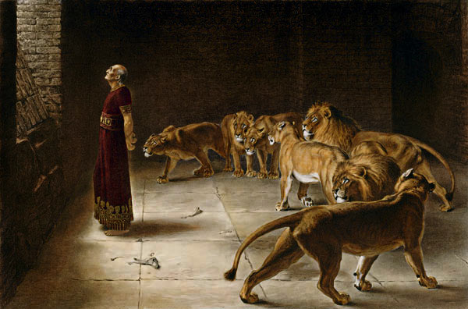

Slide 12
- 結論与应用 Conclusion and Application :
1. 人沒有能力真正除去憂慮，以基督的心為心才可以。Human being is powerless to truly remove worry. Change your mind into Christ’s mind will do.
2. 默想並背诵馬太福音6:33 你們要先求他的國、和他的義，這些東西都要加給你們了。
Meditate and Memorize Matthew 6:33 But seek first the kingdom of God and His righteousness, and all these things shall be added to you (NKJV)

