Slide 1
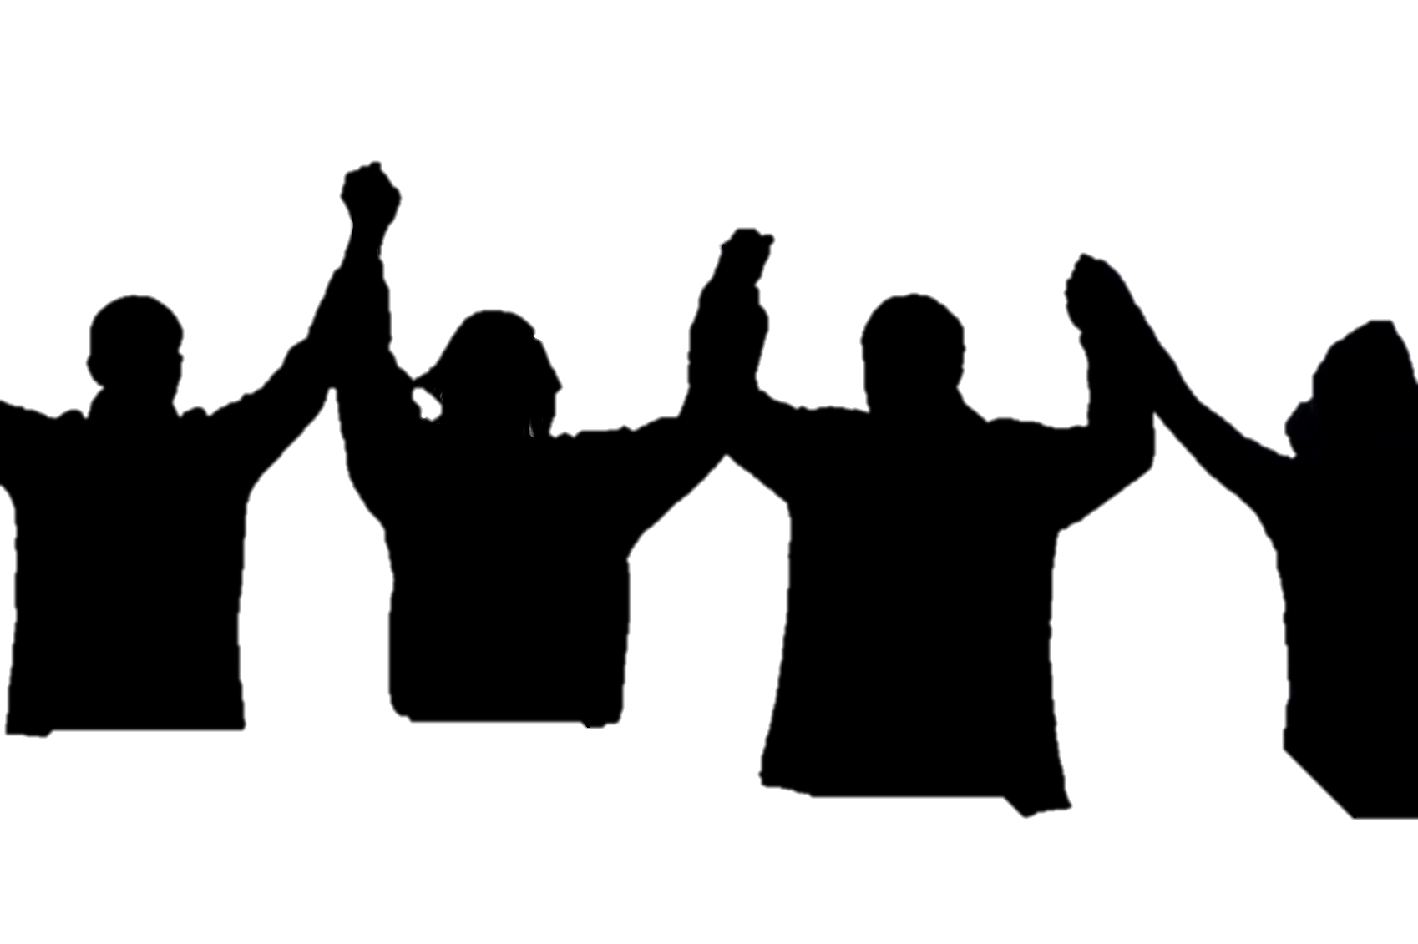
Revival @ Water Gate!
水门事件得复兴!
尼希米記Nehemiah
8:1-18
Notes:
Back to Nehemiah series.
The walls are finally built, but we are not done it.
The walls were the first step of rebuilding God’s City and God’s people.
Now they are focusing on themselves.
We will see more revival happen as we move forward, but in this chapter, we will see Nehemiah help the people of Israel reaffirm their identity as God’s people.
This chapter is long, with lots of names and numbers, but there are 3 key points we can learn from and apply to our lives.

Slide 2
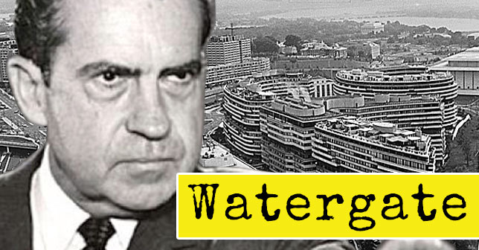

Slide 3
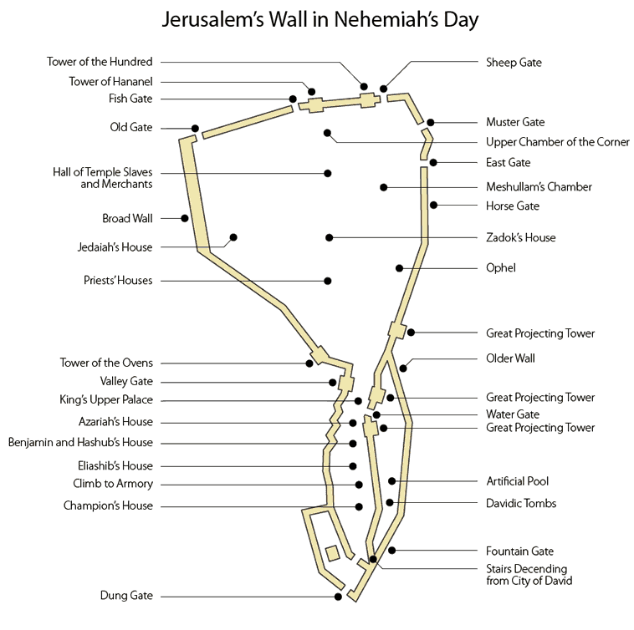

Slide 4
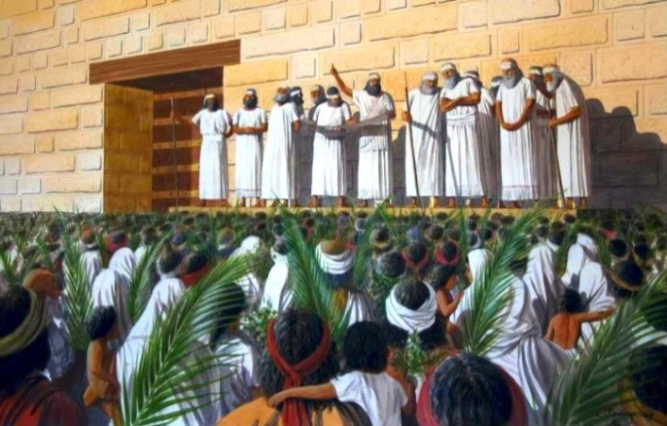

Slide 5
Nehemiah 尼希米記 8:1
And all the people gathered as one man into the square before the Water Gate. And they told Ezra the scribe to bring the Book of the Law of Moses that the Lord had commanded Israel.
到了七月, 以色列人住在自己的城里, 那时他们如同一人聚集在水门前的宽阔处, 请文士以斯拉将耶和华借摩西传给以色列人的律法书带来.

Slide 6
1. Learning from God’s Truth 學習神的真理
2. Responding to God’s Truth 回應神的真理

Slide 7
1. Learning from God’s Truth 學習神的真理
Nehemiah background 尼希米記的背景:
After God disciplined Israel for their rebellion by sending them into exile for many years, He had mercy on them and restored them through the leadership and faith of Nehemiah.
在以色列背叛遠離神, 被神管教亡國多年後, 神再次憐憫他們, 透過尼希米的信心和領導能力來重建祂的子民.

Slide 8
1. Learning from God’s Truth 學習神的真理
Nehemiah Outline 大綱:
1. Rebuilding the Wall 重建城牆 (1-7)
2. Rebuilding the People 重建人民 (8-13)

Slide 9
1. Learning from God’s Truth 學習神的真理
Nehemiah 6:15-16, 7:1
So the wall was completed on the twenty-fifth of Elul, in fifty-two days… this work had been done with the help of our God... After the wall had been rebuilt and I had set the doors in place, the gatekeepers, the musicians and the Levites were appointed.
The city was wide and large, but the people within it were few, and no houses had been rebuilt.

Slide 10
1. Learning from God’s Truth 學習神的真理
尼希米記 6:15-16, 7:1, 4
以祿月二十五日, 城牆修完了, 共修了五十二天… 因為見這工作完成是出乎我們的神
城牆修完, 我安了門扇, 守門的, 歌唱的和利未人都已派定… 城是廣大, 其中的民卻稀少, 房屋還沒有建造.

Slide 11
1. Learning from God’s Truth 學習神的真理
Nehemiah 6:15-16, 7:1
So the wall was completed on the twenty-fifth of Elul, in fifty-two days… this work had been done with the help of our God... After the wall had been rebuilt and I had set the doors in place, the gatekeepers, the musicians and the Levites were appointed.
The city was wide and large, but the people within it were few, and no houses had been rebuilt.

Slide 12
1. Learning from God’s Truth 學習神的真理
Nehemiah 8:1-2
all the people came together as one in the square before the Water Gate. They told Ezra the teacher of the Law to bring out the Book of the Law of Moses, which the Lord had commanded for Israel. So on the first day of the seventh month Ezra the priest brought the Law before the assembly, which was made up of men and women and all who were able to understand.

Slide 13
1. Learning from God’s Truth 學習神的真理
尼希米記 8:1-2
到了七月, 以色列人住在自己的城里, 那时他们如同一人聚集在水门前的宽阔处, 请文士以斯拉将耶和华借摩西传给以色列人的律法书带来. 七月初一日，祭司以斯拉将律法书带到听了能明白的男女会众面前,

Slide 14
1. Learning from God’s Truth 學習神的真理
Nehemiah 尼希米記 8:1-2
all the people came together as one in the square before the Water Gate. They told Ezra the teacher of the Law to bring out the Book of the Law of Moses…
到了七月, 以色列人住在自己的城里, 那时他们如同一人聚集在水门前的宽阔处, 请文士以斯拉将耶和华借摩西传给以色列人的律法书带来.

Slide 15
1. Learning from God’s Truth 學習神的真理
Nehemiah 尼希米記 8:3
He read it aloud from daybreak till noon as he faced the square before the Water Gate in the presence of the men, women and others who could understand. And all the people listened attentively to the Book of the Law.
在水门前的宽阔处, 从清早到晌午, 在众男女一切听了能明白的人面前读这律法书, 众民侧耳而听.

Slide 16
1. Learning from God’s Truth 學習神的真理
Ezra 7:10-12
For Ezra had devoted himself to the study and observance of the Law of the Lord, and to teaching its decrees and laws in Israel.
This is a copy of the letter King Artaxerxes had given to Ezra the priest, a teacher of the Law, a man learned in matters concerning the commands and decrees of the Lord for Israel: Artaxerxes, king of kings, To Ezra the priest, teacher of the Law of the God…

Slide 17
1. Learning from God’s Truth 學習神的真理
以斯拉记 7:10-12
以斯拉定志考究遵行耶和华的律法, 又将律例, 典章教训以色列人. 祭司以斯拉是通达耶和华诫命和赐以色列之律例的文士. 亚达薛西王赐给他谕旨, 上面写着说:“诸王之王亚达薛西, 达于祭司以斯拉, 通达天上神律法大德的文士…

Slide 18
1. Learning from God’s Truth 學習神的真理
Ezra 7:10-12
For Ezra had devoted himself to the study and observance of the Law of the Lord, and to teaching its decrees and laws in Israel.
This is a copy of the letter King Artaxerxes had given to Ezra the priest, a teacher of the Law, a man learned in matters concerning the commands and decrees of the Lord for Israel: Artaxerxes, king of kings, To Ezra the priest, teacher of the Law of the God…

Slide 19
1. Learning from God’s Truth 學習神的真理
“It is time for the church to rediscover the preeminence of the Word. And to value the teaching of the Word. We need to value truth over feeling. Truth over emotion. And what we are seeing now is the result of the church raising up influencers who did not supremely value truth who have led a generation who also do not believe in the supremacy of truth.” – John Cooper, Skillet

Slide 20
1. Learning from God’s Truth 學習神的真理
Nehemiah 8:7-8
The Levites—Jeshua, Bani, Sherebiah, Jamin, Akkub, Shabbethai, Hodiah, Maaseiah, Kelita, Azariah, Jozabad, Hanan and Pelaiah—instructed the people in the Law while the people were standing there. They read from the Book of the Law of God, making it clear and giving the meaning so that the people understood what was being read.

Slide 21
1. Learning from God’s Truth 學習神的真理
尼希米記 8:7-8
耶书亚, 巴尼, 示利比, 雅悯, 亚谷, 沙比太, 荷第雅, 玛西雅, 基利他, 亚撒利雅, 约撒拔, 哈难, 毗莱雅和利未人使百姓明白律法, 百姓都站在自己的地方. 他们清清楚楚地念神的律法书, 讲明意思, 使百姓明白所念的.

Slide 22
2. Responding to God’s Truth 回應神的真理
Nehemiah 8:5-6
Ezra opened the book. All the people could see him because he was standing above them; and as he opened it, the people all stood up. Ezra praised the Lord, the great God; and all the people lifted their hands and responded, “Amen! Amen!” Then they bowed down and worshiped the Lord with their faces to the ground.

Slide 23
2. Responding to God’s Truth 回應神的真理
尼希米記 8:5-6
以斯拉站在众民以上, 在众民眼前展开这
书. 他一展开, 众民就都站起来. 以斯拉称颂耶和华至大的神, 众民都举手应声说:
“阿门! 阿门! ”, 就低头, 面伏于地, 敬拜耶和华.

Slide 24
2. Responding to God’s Truth 回應神的真理
Nehemiah 8:5-6
Ezra opened the book. All the people could see him because he was standing above them; and as he opened it, the people all stood up. Ezra praised the Lord, the great God; and all the people lifted their hands and responded, “Amen! Amen!” Then they bowed down and worshiped the Lord with their faces to the ground.

Slide 25
2. Responding to God’s Truth 回應神的真理
Nehemiah 8:9
Then Nehemiah the governor, Ezra the priest and teacher of the Law, and the Levites who were instructing the people said to them all, “This day is holy to the Lord your God. Do not mourn or weep.” For all the people had been weeping as they listened to the words of the Law.

Slide 26
2. Responding to God’s Truth 回應神的真理
尼希米記 8:5-6
省长尼希米和做祭司的文士以斯拉, 并教训百姓的利未人对众民说:“今日是耶和华你们神的圣日, 不要悲哀哭泣.”这是因为众民听见律法书上的话都哭了.

Slide 27
2. Responding to God’s Truth 回應神的真理
Nehemiah 8:9
Then Nehemiah the governor, Ezra the priest and teacher of the Law, and the Levites who were instructing the people said to them all, “This day is holy to the Lord your God. Do not mourn or weep.” For all the people had been weeping as they listened to the words of the Law.

Slide 28
2. Responding to God’s Truth 回應神的真理
Nehemiah 8:10-11
Nehemiah said, “Go and enjoy choice food and sweet drinks, and send some to those who have nothing prepared. This day is holy to our Lord. Do not grieve, for the joy of the Lord is your strength.” The Levites calmed all the people, saying, “Be still, for this is a holy day. Do not grieve.”

Slide 29
2. Responding to God’s Truth 回應神的真理
尼希米記 8:10-11
又对他们说:“你们去吃肥美的, 喝甘甜的, 有不能预备的就分给他, 因为今日是我们主的圣日. 你们不要忧愁, 因靠耶和华而得的喜乐是你们的力量.”于是利未人使众民静默, 说:“今日是圣日, 不要作声, 也不要忧愁.”

Slide 30
2. Responding to God’s Truth 回應神的真理
Nehemiah 8:10-11
Nehemiah said, “Go and enjoy choice food and sweet drinks, and send some to those who have nothing prepared. This day is holy to our Lord. Do not grieve, for the joy of the Lord is your strength.” The Levites calmed all the people, saying, “Be still, for this is a holy day. Do not grieve.”

Slide 31
2. Responding to God’s Truth 回應神的真理
我們因知罪認罪所帶來的痛悔絕不能超過我們因主耶穌的赦免和恩典所帶來的喜樂和感恩!
Our remorse towards our sins must not be greater than our joy and thanksgiving in the Lord’s grace and forgiveness!

Slide 32
2. Responding to God’s Truth 回應神的真理
Nehemiah 8:12
Then all the people went away to eat and drink, to send portions of food and to celebrate with great joy, because they now understood the words that had been made known to them.
Obedience to God’s truth is not controlled by our feelings, but our feelings must be controlled by God’s truth!

Slide 33
2. Responding to God’s Truth 回應神的真理
尼希米記 8:11-12
於是利未人使眾民靜默, 說:“今日是聖
日, 不要作聲, 也不要憂愁.”眾民都去吃喝, 也分給人, 大大快樂, 因為他們明白所教訓他們的話.
我們順服神的真理不是靠情緒控制,
而我們的情緒必須要靠神的真理來帶領!

Slide 34
2. Responding to God’s Truth 回應神的真理
Nehemiah 8:13-15
On the second day of the month, the heads of all the families, along with the priests and the Levites, gathered around Ezra the teacher to give attention to the words of the Law. They found written in the Law, which the Lord had commanded through Moses, that the Israelites were to live in temporary shelters during the festival of the seventh month. and that they should proclaim this word and

Slide 35
2. Responding to God’s Truth 回應神的真理
Nehemiah 8:13-15
spread it throughout their towns and in Jerusalem: “Go out into the hill country and bring back branches from olive and wild olive trees, and from myrtles, palms and shade trees, to make temporary shelters”—as it is written.

Slide 36
2. Responding to God’s Truth 回應神的真理
尼希米記 8:13-15
次日, 众民的族长, 祭司和利未人都聚集到文士以斯拉那里, 要留心听律法上的话. 他们见律法上写着, 耶和华借摩西吩咐以色列人要在七月节住棚, 并要在各城和耶路撒冷宣传报告说:“你们当上山, 将橄榄树, 野橄榄树, 番石榴树, 棕树和各样茂密树的枝子取来, 照着所写的搭棚.”

Slide 37
2. Responding to God’s Truth 回應神的真理
Leviticus 23:42-43
Live in temporary shelters for seven days: All native-born Israelites are to live in such shelters so your descendants will know that I had the Israelites live in temporary shelters when I brought them out of Egypt. I am the Lord your God.’

Slide 38
2. Responding to God’s Truth 回應神的真理
利未记 23:33-34, 42-43
耶和华对摩西说:“你晓谕以色列人说: 这七月十五日是住棚节, 要在耶和华面前守这节七日… 你们要住在棚里七日, 凡以色列家的人都要住在棚里, 好叫你们世世代代知道, 我领以色列人出埃及地的时候曾使他们住在棚里. 我是耶和华你们的神.”

Slide 39
2. Responding to God’s Truth 回應神的真理
Nehemiah 8:16-17
So the people went out and brought back branches and built themselves temporary shelters on their own roofs, in their courtyards, in the courts of the house of God and in the square by the Water Gate and the one by the Gate of Ephraim. The whole company that had returned from exile built temporary shelters and lived in them.

Slide 40
2. Responding to God’s Truth 回應神的真理
尼希米記 8:16-17
于是百姓出去, 取了树枝来, 各人在自己的房顶上, 或院内, 或神殿的院内, 或水门的宽阔处, 或以法莲门的宽阔处搭棚. 从掳到之地归回的全会众就搭棚, 住在棚里.

Slide 41
2. Responding to God’s Truth 回應神的真理
Nehemiah 尼希米記 8:17
From the days of Joshua son of Nun until that day, the Israelites had not celebrated it like this. And their joy was very great.
从嫩的儿子约书亚的时候直到这日, 以色列人没有这样行. 于是众人大大喜乐.

Slide 42
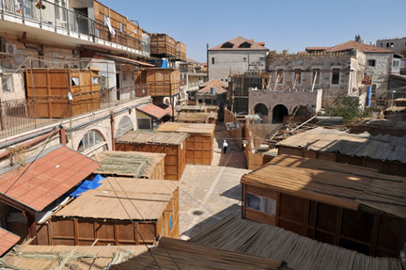

Slide 43
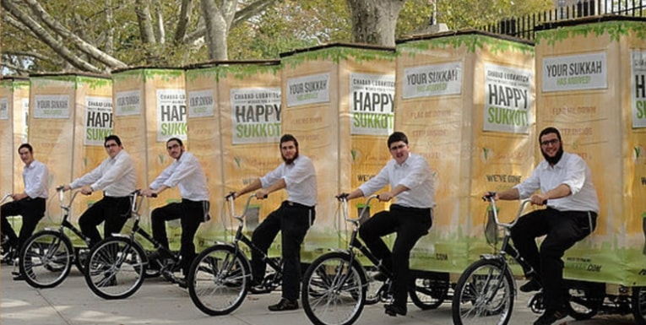

Slide 44
2. Responding to God’s Truth 回應神的真理
Nehemiah 尼希米記 8:18
Day after day, from the first day to the last, Ezra read from the Book of the Law of God. They celebrated the festival for seven days, and on the eighth day, in accordance with the regulation, there was an assembly.
从头一天直到末一天, 以斯拉每日念神的律法书. 众人守节七日, 第八日照例有严肃会.

Slide 45
Today we have the complete Word of God,
what is our attitude towards God’s Word?
Are we eagerly seeking to study and obey God’s Word fully?
今天我們擁有完整全備的神的真理,
我們對神的真理現在有什麼態度？
我們有熱切恆心的去學習和遵守
神的真理嗎？

Slide 46
We have a choice today今天我們有選擇:
the shameful Watergate
or the beautiful Watergate?
水門的醜事還是水門的美事？

