Slide 1
Series: Luke – The Lord’s Favor Has Come
Lk 路 18:1-17
Please Show
Your I.D.
請顯示你的
身份證

Slide 2
I.D.: Feline, Canine

Slide 3
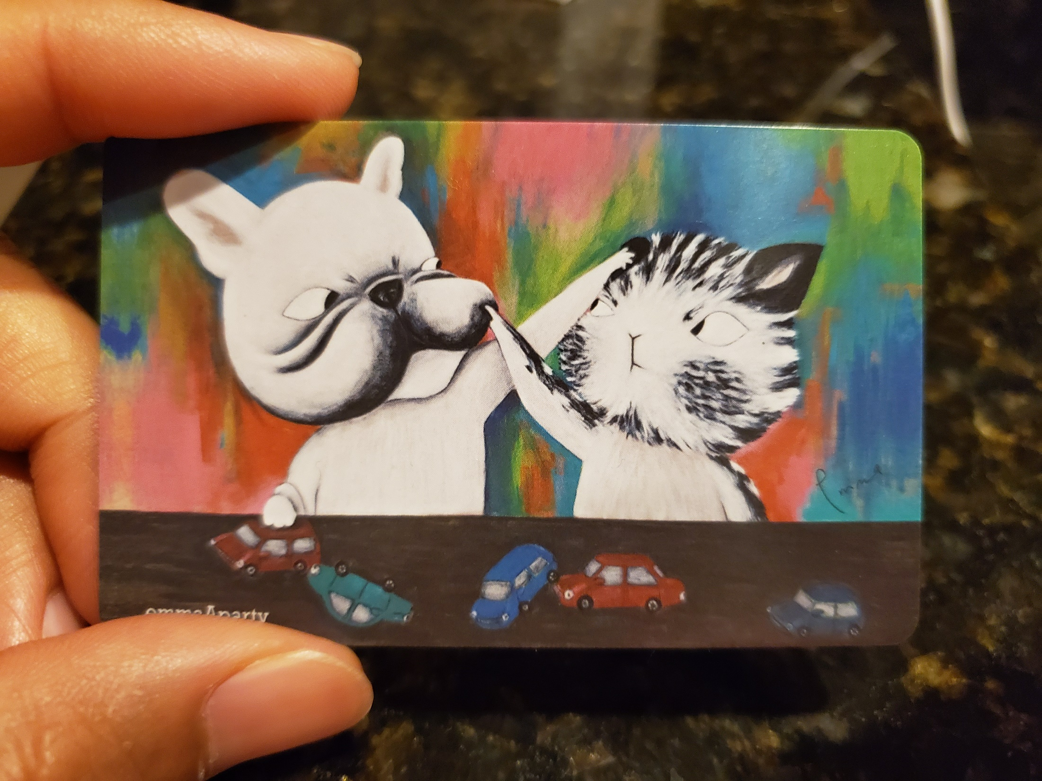

Slide 4
Lk 路 18:8b
However, when the Son of Man comes, will he find faith on the earth?
然 而 ， 人 子 來 的 時 候 ， 遇 得 見 世 上 有 信 德 麼 ？

Slide 5
Lk 路 18:1-17

Slide 6
Lk 路 18:8
I tell you, He will see that His chosen ones get justice, and quickly. However, when the Son of Man comes, will he find faith on the earth?” ？
我 告 訴 你 們 ， 要 快 快 的 給 神 的 選 民 伸 冤 了 。 然 而 ， 人 子 來 的 時 候 ， 遇 得 見 世 上 有 信 德 麼

Slide 7
Lk 路 18:14
“I tell you that this man, rather than the other, went home justified before God. For all those who exalt themselves will be humbled, and those who humble themselves will be exalted.”
我 告 訴 你 們 ， 這 人 回 家 去 比 那 人 倒 算 為 義 了 ； 因 為 ， 凡 自 高 的 ， 必 降 為 卑 ； 自 卑 的 ， 必 升 為 高 。

Slide 8
Lk 路 18:17
Truly I tell you, anyone who will not receive the kingdom of God like a little child will never enter it.”
我 實 在 告 訴 你 們 ， 凡 要 承 受 神 國 的 ， 若 不 像 小 孩 子 ， 斷 不 能 進 去 。

Slide 9
The God-centering message of Lk 18:1-17:
God’s people are fully trusting of God, fully humble before God, and fully dependent on God.
神的子民全然相信神，全然謙卑於神面前，全然依靠神。

Slide 10
I.D.: Feline, Canine:
If we have confessed our belief in God, are these distinct features of the Christian faith present and maturing in us?

Slide 11
God Hears
the Trusting

Slide 12
God Hears the Trusting:
“Always” = Continual (vs. continuous)
< > The Christian faith WILL lead the Christian to pray continually

Slide 13
God Hears the Trusting:
“Give up” = To be disappointed, discouraged, in despair/ lose hope < > Dangerous, for the giving up is an action toward God, a belief shaken
“Always” = Continual (vs. continuous)
< > The Christian faith WILL lead the Christian to pray continually

Slide 14
God Justifies
the Humble

Slide 15
God Justifies the Humble:
A Pharisee and a tax collector
< > (in the eyes of Man)
Big contrast in social standing
< > (in the eyes of God)
Big contrast in divine/ spiritual standing

Slide 16
God Justifies the Humble:
Four features of humility:
He does not deserve to be near the holy sanctuary

Slide 17
God Justifies the Humble:
Four features of humility:
He does not deserve to be near the holy sanctuary
He dare not present/ presume himself fit in God’s domain

Slide 18
God Justifies the Humble:
Four features of humility:
He does not deserve to be near the holy sanctuary
He dare not present/ presume himself fit in God’s domain
He is gesturally sorrowful (for his sin)

Slide 19
God Justifies the Humble:
Four features of humility:
He does not deserve to be near the holy sanctuary
He dare not present/ presume himself fit in God’s domain
He is gesturally sorrowful (for his sin)
He openly confesses his spiritual state and need

Slide 20
God Justifies the Humble:
It is the humble soul that will gain God’s hearing. It is the dependent soul who will be pronounced as right by God – not that the tax collector was sinless, but that he is sinful but forgiven in trusting and asking for God’s mercy toward his sinfulness.

Slide 21
God Receives
the Dependent

Slide 22
God Receives the Dependent:
They are to believe in God and His kingdom as people who are TOTALLY dependent on God in their lives.

Slide 23
I.D.: Prayer Divine

Slide 24
Lk 路 18:8b
However, when the Son of Man comes, will he find faith on the earth?
然 而 ， 人 子 來 的 時 候 ， 遇 得 見 世 上 有 信 德 麼 ？

Slide 25
I.D.: Prayer Divine:
V. 1 A prayer less & a prayerless soul is one that has given up on faith in God
o No petition = No need for God
o No praise = No regard for God
o No contrition = No fear for God

Slide 26
~ Manny Mill, Radical Prayer
We cannot have a relationship with someone if we do not spend time facing the person. And when we face someone, we address the individual, we acknowledge who she or he is.

Slide 27
~ Manny Mill, Radical Prayer
We cannot have a relationship with someone if we do not spend time facing the person. And when we face someone, we address the individual, we acknowledge who she or he is. … … …We remind ourselves that it is not just some form of meditation used to calm our inner beings and make us feel better. We are not just talking to the air – we are talking to the God of the universe.

Slide 28
I.D.: Prayer Divine:
DO WE EVEN HAVE THE FAITH FOR (many) “ONE MINUTE” WITH GOD?

Slide 29


Slide 30
I.D.: Prayer Divine:
Our persistent prayers – long and short – will add up, to remind us:
o To trust fully in our God who is just
o To fully be humble before our God who is infinitely grand and with authority
o To depend fully on our God who holds our lives in His good hands

Slide 31
Selah (Holy Communion):
Here’s to one minute of prayer
___Remember God’s mercy to us while we were still sinners;
continue to ask for God’s mercy to transform us into people of the faith that will pray

