Slide 1
读 经 Scripture Reading
马太福音 13:44-46
天國好像寶貝藏在地裡．人遇見了、就把他藏起來．歡歡喜喜的去變賣一切所有的、買這塊地。45天國又好像買賣人、尋找好珠子．46遇見一顆重價的珠子、就去變賣他一切所有的、買了這顆珠子。

Slide 2
Matthew 13: 44-46
⁴⁴ “Again, the kingdom of heaven is like treasure hidden in a field, which a man found and hid; and for joy over it he goes and sells all that he has and buys that field.⁴⁵ “Again, the kingdom of heaven is like a merchant seeking beautiful pearls, ⁴⁶ who, when he had found one pearl of great price, went and sold all that he had and bought it. (NKJV)

Slide 3
无价的珍宝 Priceless Treasure
經文 Scripture:
Matthew 13:44-46
讲员：冯伟牧师
Preacher：Pastor Wei Feng

Slide 4
前言Introduction:
Mastercard Priceless Commercial (Baseball Game)
https://www.youtube.com/watch?v=Q_6stXKGuHo

Slide 5
前言Introduction:
Mastercard Priceless Commercial (Baseball Game)

Slide 6
前言Introduction:
在交换对比中，价值体现出来。每個人眼中都有自己最看重的。家人、父母、子女、生命可能對大部分人是最重要的。天國的福音，值得我們這樣地去珍視、尋求。
In exchange and comparison, value shows up. Everyone has what he/she treasures the most. Family, parents, children, life usually are the most precious to most people. The gospel of Kingdom of Heaven, is worth to seek and to treasure just like those.

Slide 7
I. 珍寶找人 Treasure Seeks Man 13: 44
II. 人找珍寶Man Seeks Treasure 13:45

Slide 8
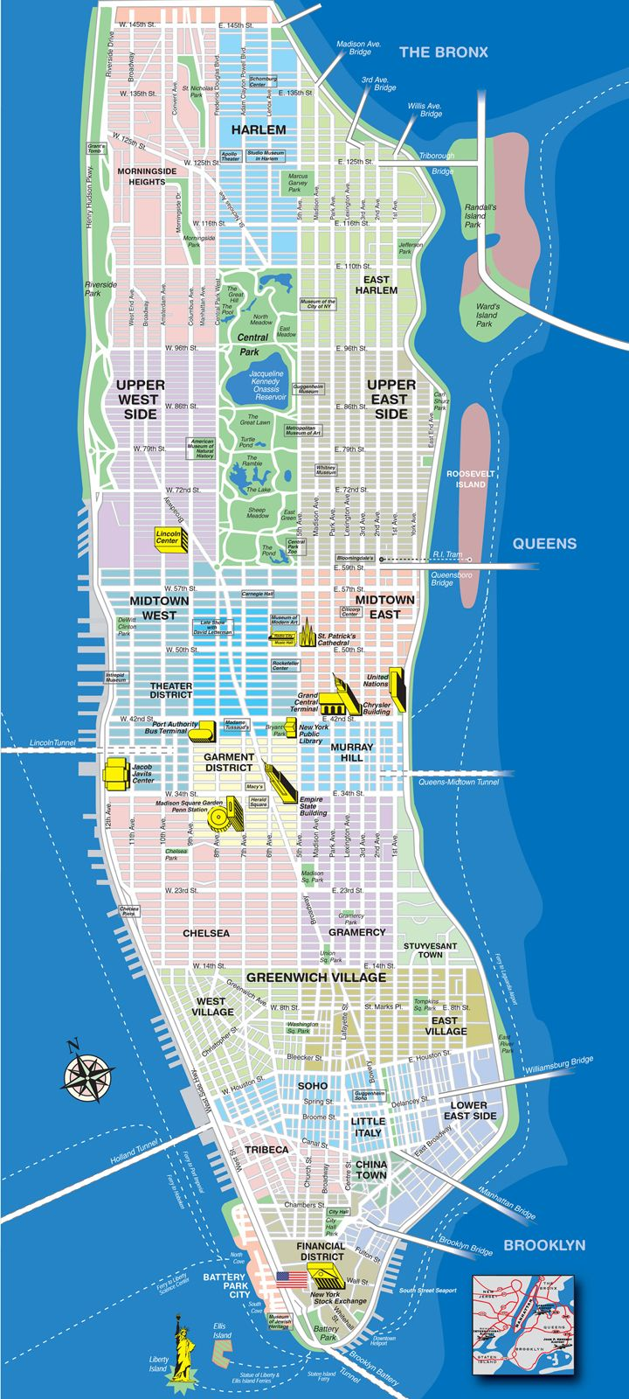
III.價值Price 13: 44, 46
Manhatten Purchase (1626 from Native American, $24)

Slide 9
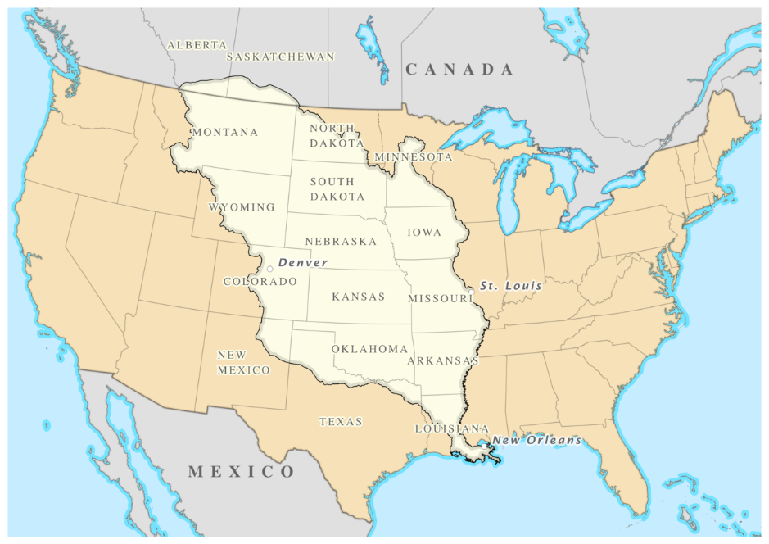
III.價值Price 13: 44, 46
Louisiana Purchase (1803 from France)
827,000 sq miles, 15 million USD (3 cents/acre)

Slide 10
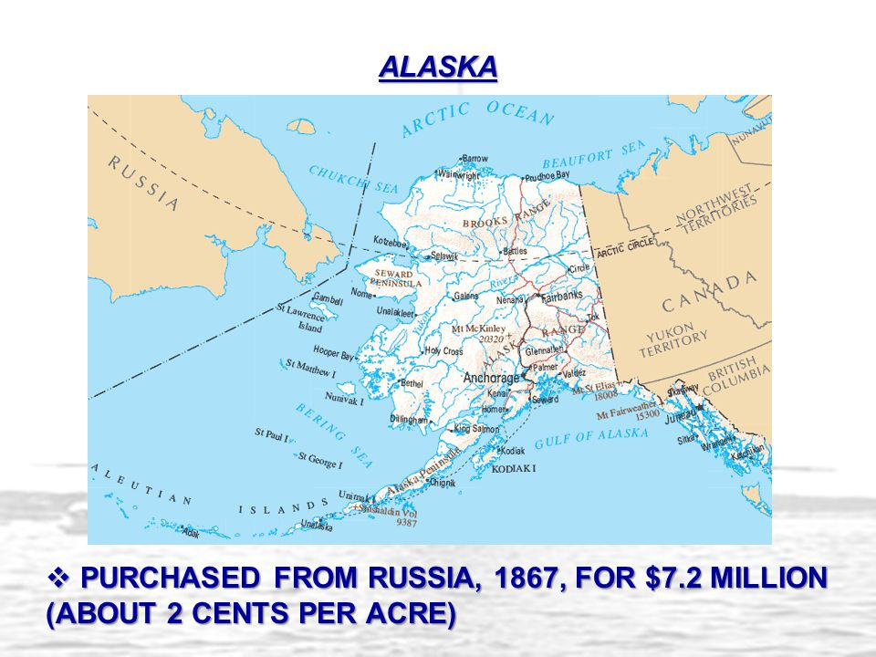
III.價值Price 13: 44, 46

Slide 11
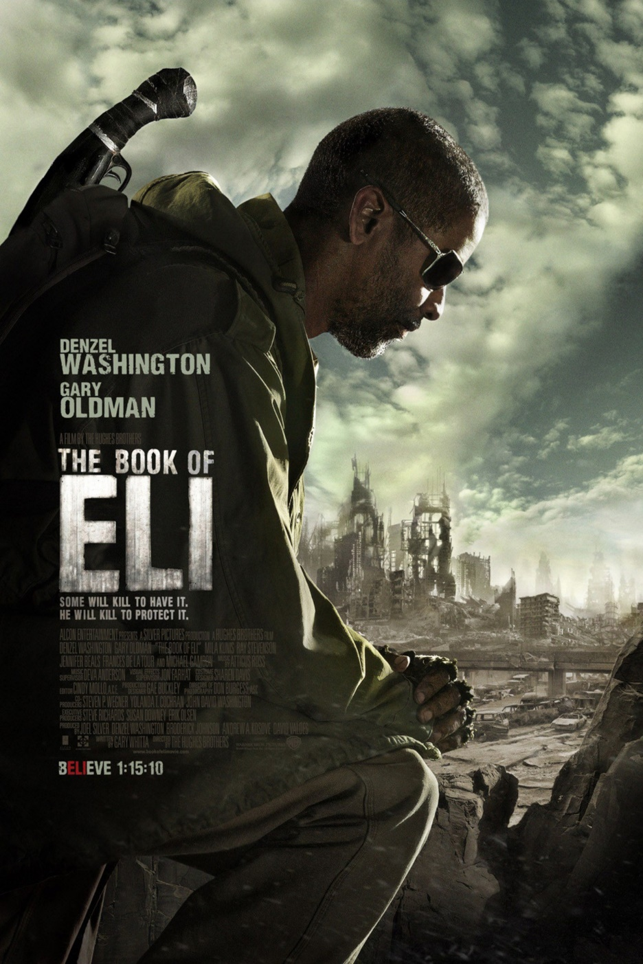
III.價值Price 13: 44, 46

Slide 12
III.價值Price 13: 44, 46
路加福音Luke 17:21 人也不得說、看哪、在這裡．看哪、在那裡．因為神的國就在你們心裡。〔心裡或作中間〕
箴言 Proverbs 4:23 你要保守你心、勝過保守一切，因為一生的果效、是由心發出。
腓立比書 Philippians 3:8 不但如此、我也將萬事當作有損的、因我以認識我主基督耶穌為至寶。我為他已經丟棄萬事、看作糞土、為要得著基督。
馬太福音 Matthew 16:25-26 因為凡要救自己生命的、必喪掉生命．凡為我喪掉生命的、必得著生命。人若賺得全世界、賠上自己的生命、有甚麼益處呢．人還能拿甚麼換生命呢？

Slide 13
III.價值Price 13: 44, 46
馬可福音 Mark 10:28-30
彼得就對他說、看哪、我們已經撇下所有的跟從你了。耶穌說、我實在告訴你們、人為我和福音、撇下房屋、或是弟兄、姐妹、父母、兒女、田地。沒有不在今世得百倍的、就是房屋、弟兄、姐妹、母親、兒女、田地、並且要受逼迫．在來世必得永生。

Slide 14
結論与回應 Conclusion and Response:
1. 對人最寶貴的有正負兩類。你今生最寶貴的是什麼？There are two kinds of most valuable things：positive and negative. What is the most valuable to you in this life?
2. 你是否願意放下一切，得到耶穌？Are you willing to give up everything to obtain Christ?
3. 默想並背诵路加福音9: 23: “耶穌又對眾人說、若有人要跟從我、就當捨己、天天背起他的十字架來、跟從我” Meditate and Memorize Luke 9:23 Then He said to them all, “If anyone desires to come after Me, let him deny himself, and take up his cross daily, and follow Me. （NJKV）

Slide 15
《举目》微信公众号

