Slide 1
Series: Last Words of a Crucified Christ
Lk 路 23:34
From Didn’t
To Do
從過往的沒有
到現今的有

Slide 2
I Didn’t Know x 2

Slide 3
I Didn’t Know x 2:
There is much that we do not know < > We actually do not know just how much we do not know.

Slide 4
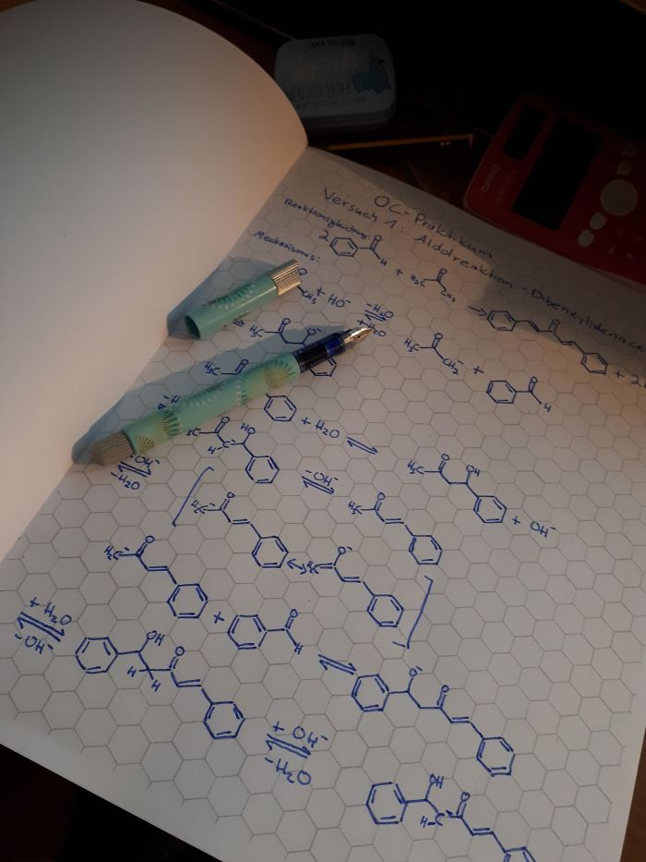
https://www.boredpanda.com/genius-ideas-solutions/

Slide 5
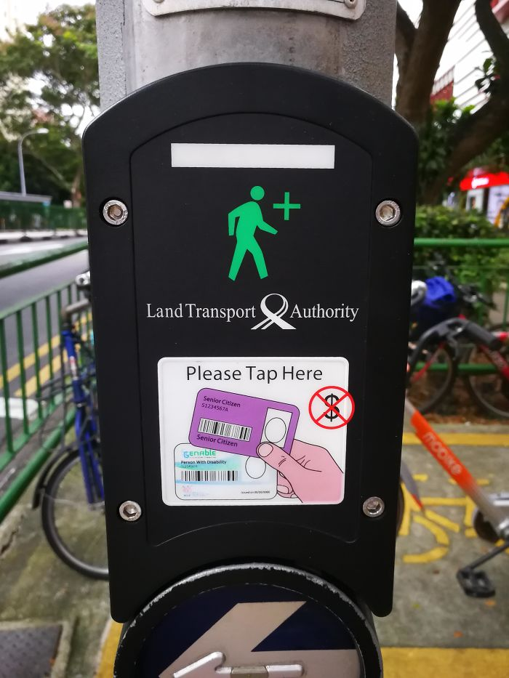
https://www.boredpanda.com/genius-ideas-solutions/

Slide 6
https://www.boredpanda.com/genius-ideas-solutions/

Slide 7
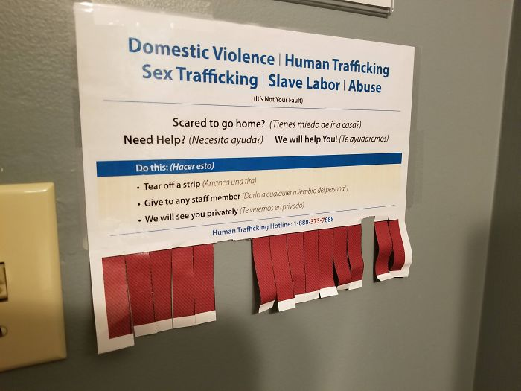
https://www.boredpanda.com/genius-ideas-solutions/

Slide 8
I Didn’t Know x 2:
There is one ignorance that will end life and bring death for all eternity for each and every person i.e. This ignorance is our ignorance toward God, which aggravates our arrogance toward God, which consolidates our distance from God, leading to eternal death.

Slide 9
I Didn’t Know x 2:
1/ Our ignorance toward God is forgivable only by God and no other.

Slide 10
I Didn’t Know x 2:
1/ Our ignorance toward God is forgivable only by God and no other.
2/ God has offered the forgiveness of this ignorance that leads to eternal death i.e. If and when we believe in Jesus who, when crucified, said, “Father, forgive them, for they do not know what they are doing.”

Slide 11
Lk 路23:32-38

Slide 12
Lk 23:32-38
32 Two other men, both criminals, were also led out with him to be executed. 33 When they came to the place called the Skull, they crucified him there, along with the criminals—one on his right, the other on his left. 34 Jesus said, “Father, forgive them, for they do not know what they are doing.” And they divided up his clothes by casting lots.

Slide 13
Lk 23:32-38
35 The people stood watching, and the rulers even sneered at him. They said, “He saved others; let him save himself if he is God’s Messiah, the Chosen One.” 36 The soldiers also came up and mocked him. They offered him wine vinegar 37 and said, “If you are the king of the Jews, save yourself.” 38 There was a written notice above him, which read: this is THE KING OF THE JEWS.

Slide 14
Lk 23:32-38
32 又 有 兩 個 犯 人 ， 和 耶 穌 一 同 帶 來 處 死 。33 到 了 一 個 地 方 ， 名 叫 髑 髏 地 ， 就 在 那 裡 把 耶 穌 釘 在 十 字 架 上 ， 又 釘 了 兩 個 犯 人 ： 一 個 在 左 邊 ， 一 個 在 右 邊 。34 當 下 耶 穌 說 ： 父 阿 ！ 赦 免 他 們 ； 因 為 他 們 所 做 的 ， 他 們 不 曉 得 。 兵 丁 就 拈 鬮 分 他 的 衣 服 。

Slide 15
Lk 23:32-38
35 百 姓 站 在 那 裡 觀 看 。 官 府 也 嗤 笑 他 ， 說 ： 他 救 了 別 人 ； 他 若 是 基 督 ， 神 所 揀 選 的 ， 可 以 救 自 己 罷 ！ 36 兵 丁 也 戲 弄 他 ， 上 前 拿 醋 送 給 他 喝 ，37 說 ： 你 若 是 猶 太 人 的 王 ， 可 以 救 自 己 罷 ！38 在 耶 穌 以 上 有 一 個 牌 子 寫 著 ： 這 是 猶 太 人 的 王 。

Slide 16
Lk 23:34
34 Jesus said, “Father, forgive them, for they do not know what they are doing.” And they divided up his clothes by casting lots.
34 當 下 耶 穌 說 ： 父 阿 ！ 赦 免 他 們 ； 因 為 他 們 所 做 的 ， 他 們 不 曉 得 。 兵 丁 就 拈 鬮 分 他 的 衣 服 。

Slide 17
A Kingly Act

Slide 18
The God-centering message of Lk 23:34:
Forgiveness is the missional, merciful act of the crucified Christ.
原諒乃是被釘十字架的基督所做出那帶使命、帶憐憫的作為。

Slide 19
Jn 3:17
17 For God did not send his Son into the world to condemn the world, but to save the world through him.
17 因 為 神 差 他 的 兒 子 降 世 ， 不 是 要 定 世 人 的 罪， 乃 是 要 叫 世 人 因 他 得 救 。

Slide 20
A Kingly Act:
The issue at hand is not whether he is a criminal or not, if he has done wrong or not; the issue at hand is whether he is as he claimed to be i.e. the Christ/ Messiah, the one anointed by God to be the King

Slide 21
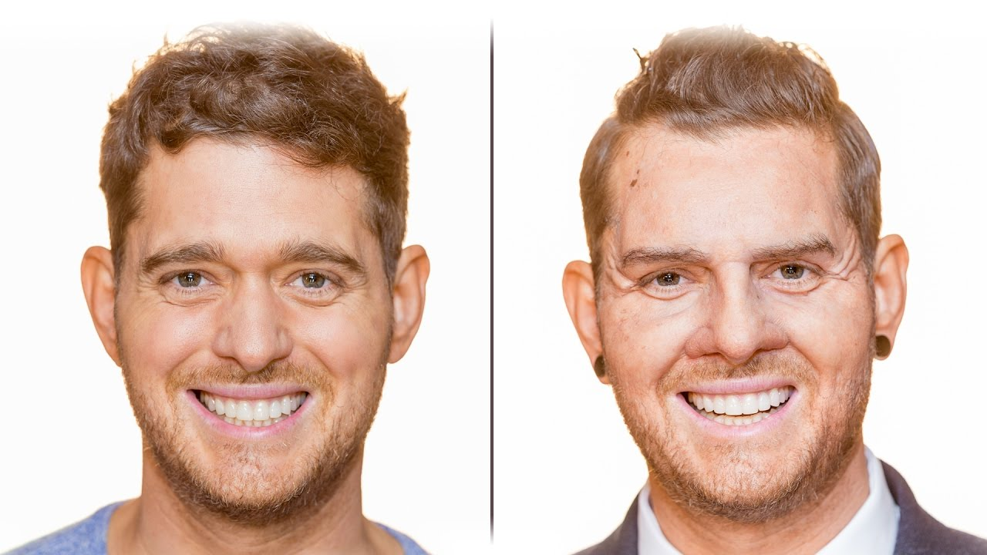
Michael the singer
Dion the sales assistant
https://www.youtube.com/watch?v=I-yfuM_QDcQ

Slide 22
A Kingly Act:
Jesus is the King who:
For all the power in his hands, opens up his hands to be nailed to the cross;
for all the power in his mouth, petitions for the forgiveness of those who crucified him.

Slide 23
Psa 14:3
3 All have turned away, all have become corrupt; there is no one who does good, not even one.
3 他 們 都 偏 離 正 路 ， 一 同 變 為 污 穢 ； 並 沒 有 行 善 的 ， 連 一 個 也 沒 有 。

Slide 24
A Kingly Act:
Forgiveness is the act of the King who is on a mission to save.

Slide 25
A Kingly Act:
Forgiveness is the act of the King who is on a mission to save.
The distance with God will be bridged, the arrogance toward God will transformed into humility; the ignorant sinner will know God personally, intimately, lovingly.

Slide 26
A Kingly Act:
Forgiveness is the act of the King who is bent on showing mercy.

Slide 27
A Kingly Act:
Forgiveness is the act of the King who is bent on showing mercy.
By giving the petition, Jesus is essentially saying, “I must be continue on this cross. Without my sacrifice, there can be not forgiveness of their ignorance.”
→ As if a request for God to never abort this mission!

Slide 28
A Kingly Act:
Jesus took upon himself the judgment of God, on our behalf; he shows us mercy by not giving us the punishment we deserve.

Slide 29
From Didn’t to Do

Slide 30
From Didn’t to Do:
1/ We must be humbled by God’s forgiveness.

Slide 31
Psa 14:3
5 For God knows that when you eat from it your eyes will be opened, and you will be like God, knowing good and evil. 6 When the woman saw that the fruit of the tree was … also desirable for gaining wisdom …
5 因 為 神 知 道 ， 你 們 吃 的 日 子 眼 睛 就 明 亮 了 ， 你 們 便 如 神 能 知 道 善 惡 。6 於 是 女 人 見 那 棵 樹 的 果 子 … 能 使 人 有 智 慧 …

Slide 32
From Didn’t to Do:
Under the tree of the knowledge of good and evil, the first humans declared: We want to know as God knows. We must know.

Slide 33
From Didn’t to Do:
Under the tree of the knowledge of good and evil, the first humans declared: We want to know as God knows. We must know. BUT now, hanging from the tree of humiliation, the perfect Adam declares: They do not know. All y’all do not know.

Slide 34
From Didn’t to Do:
1/ We must be humbled by God’s forgiveness.
2/ We must be humble to forgive, just as God has forgiven us.

Slide 35
From Didn’t to Do:
“For we know not what we do to others”
“For they know not what they do to us”

Slide 36
From Didn’t to Do:
It is our most trying circumstance/ our most painful moment/ our greatest guilt/ … that will reveal who the real “Lord and Savior” in our lives is.

Slide 37
From Didn’t to Do:
It is our most trying circumstance/ our most painful moment/ our greatest guilt/ … that will reveal who the real “Lord and Savior” in our lives is.
→ For the Cross shows us that the real Lord and Savior is one who wills to show mercy while acknowledging the evil at hand.

Slide 38
Selah:
___Ask to be forgiven by faith in Jesus
___Ask to forgive another
___Ask to be humbled by God’s forgiveness
___Ask to be humble to forgive another

