Slide 1
2019 Theme: Walk With God 與神同行
Micah 6 彌迦書第六章
Talk the Walk,
Walk the Talk
說到行道，行到說道

Slide 2
CCMC 2019 Theme 主題:
Walk With God
與神同行
Micah 6:8 彌迦書六章八節

Slide 3
This is My School …?

Slide 4

https://www.pinterest.com/pin/398779741975587567/

Slide 5
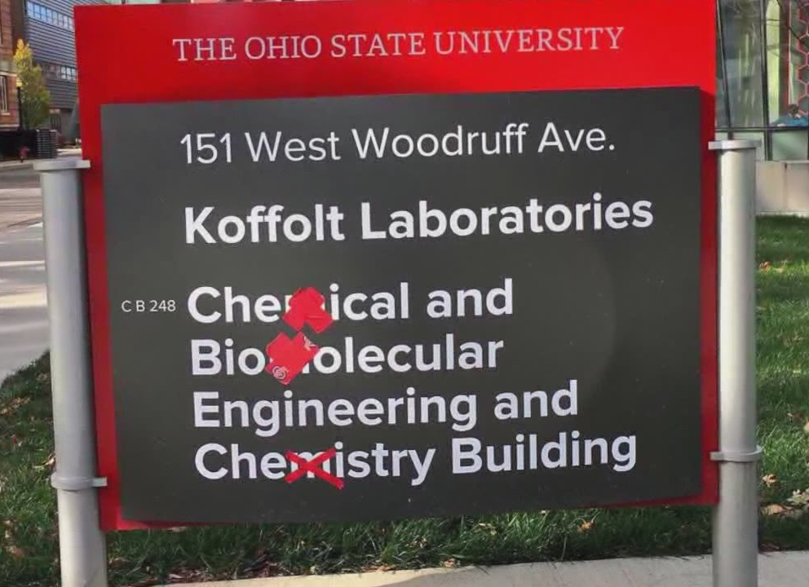
https://www.youtube.com/watch?v=y5x3rghNuFg

Slide 6
This is My School …?:
I did not know that I will be asked the question:
What then is your allegiance as a student of OSU?
Right down to the color choice of my apparel!

Slide 7
“Yes, I Am.”
“Eh, So What If
You Are?”

Slide 8
“Yes, I Am.” “Eh, So What If You Are?”:
Who then is our allegiance, dear brothers and sisters of CCMC?
On whose name do you and I make our daily decisions?

Slide 9
The God-centering message of Micah 6:
一個行公義、好憐憫、存謙卑的心與神同行的人，是對神有真信心的人。
A person of true faith in God is he or she who acts justly, loves mercy and walks humbly with God.

Slide 10
Micah 6
彌迦書第六章

Slide 11
Micah 6:8
8 世 人 哪 ， 耶 和 華 已 指 示 你 何 為 善 。 他 向 你 所 要 的 是 甚 麼 呢 ？ 只 要 你 行 公 義 ， 好 憐 憫 ， 存 謙 卑 的 心 ， 與 你 的 神 同 行 。
8 He has shown you, O mortal, what is good. And what does the LORD require of you? To act justly and to love mercy and to walk humbly with your God.

Slide 12
The God-centering message of Micah 6:
一個行公義、好憐憫、存謙卑的心與神同行的人，是對神有真信心的人。
A person of true faith in God is he or she who acts justly, loves mercy and walks humbly with God.

Slide 13
“Yes, I Am.” “Eh, So What If You Are?”:
We will not walk with God in humility UNLESS we remember + revere who He is and what He has done.

Slide 14
“Yes, I Am.” “Eh, So What If You Are?”:
By not remembering that God is just and that God is kind to them, God’s people became:
___Cavalier about their sins
___Insistent on their own ways

Slide 15
“Yes, I Am.” “Eh, So What If You Are?”:
By not remembering that God is just and that God is kind to them, God’s people became:
___Cavalier about their sins
___Insistent on their own ways
By the way they had lived their lives, they essentially said to God, “Eh, so what if you are God?”

Slide 16
Micah 6:3-5
3 我 的 百 姓 啊 ， 我 向 你 做 了 甚 麼 呢 ？ 我 在 甚 麼 事 上 使 你 厭 煩 ？ 你 可 以 對 我 證 明 。4 我 曾 將 你 從 埃 及 地 領 出 來 ， 從 作 奴 僕 之 家 救 贖 你 ； 我 也 差 遣 摩 西 、 亞 倫 ， 和 米 利 暗 在 你 前 面 行 。5 我 的 百 姓 啊 ， 你 們 當 追 念 摩 押 王 巴 勒 所 設 的 謀 和 比 珥 的 兒 子 巴 蘭 回 答 他 的 話 ， 並 你 們 從 什 亭 到 吉 甲 所 遇 見 的 事 ， 好 使 你 們 知 道 耶 和 華 公 義 的 作 為 。

Slide 17
Micah 6:3-5
3 “My people, what have I done to you? How have I burdened you? Answer Me. 4 I brought you up out of Egypt and redeemed you from the land of slavery. I sent Moses to lead you, also Aaron and Miriam. 5 My people, remember what Balak king of Moab plotted and what Balaam son of Beor answered. Remember your journey from Shittim to Gilgal, that you may know the righteous acts of the Lord.”

Slide 18
“Yes, I Am.” “Eh, So What If You Are?”:
Vv. 4-5 God recounts the enduring kindness toward Israel;
if the mountains and hills could speak, these are the events they will recount.

Slide 19
“Yes, I Am.” “Eh, So What If You Are?”:
He is not just saying that they are dear to Him but He actually shows them love
< > In all His might, He is for them, not against them.

Slide 20
“Yes, I Am.” “Eh, So What If You Are?”:
He is not just saying that they are dear to Him but He actually shows them love
< > In all His might, He is for them, not against them.
I am God and I steadfastly love you as my own, Israel.

Slide 21
“Yes, I Am.” “Eh, So What If You Are?”:
V. 16a as the summary of all their evils: IDOLATRY
i.e. “The statutes of Omri and all the practices of Ahab’s house”= The sins of Jeroboam

Slide 22
1 Kgs 14:9
9 為 自 己 立 了 別 神 ， 鑄 了 偶 像 ， 惹 我 發 怒 ， 將 我 丟 在 背 後 。
9 You have made for yourself other gods, idols made of metal; you have aroused My anger and turned your back on Me.

Slide 23
“Yes, I Am.” “Eh, So What If You Are?”:
When the allegiance is to Sin & Self, and not God, it follows that the consequence of the allegiance is destruction and death, rather than prosperity and life.
< > Israel of old has pushed away God’s staff of guidance and provision, and so brought upon them God’s “9a rod (of judgment)”

Slide 24
You are My God,
Our God!

Slide 25
You are My God, Our God!:
But the Israel of old did not take God’s goodness seriously;
they laid claim to the title of God’s chosen people, but God’s righteousness and kindness never became a source of gratitude nor a motivation to live for them (nominal, lifeless faith).

Slide 26
You are My God, Our God!:
Who then is our allegiance?
On whose name do you and I make our daily decisions?
Who or what makes the new year “Happy”?

Slide 27
Jn 10:10
10 盜 賊 來 ， 無 非 要 偷 竊 ， 殺 害 ， 毀 壞 ； 我 來 了 ， 是 要 叫 羊 得 生 命 ， 並 且 得 的 更 豐 盛 。
10 The thief comes only to steal and kill and destroy; I have come that they may have life, and have it to the full.

Slide 28
Jn 15:5
5 我 是 葡 萄 樹 ， 你 們 是 枝 子 。 常 在 我 裡 面 的 ， 我 也 常 在 他 裡 面 ， 這 人 就 多 結 果 子 ； 因 為 離 了 我 ， 你 們 就 不 能 做 甚 麼 。
5 I am the vine; you are the branches. If you remain in me and I in you, you will bear much fruit; apart from me you can do nothing.

Slide 29
You are My God, Our God!:
Our sinfulness will not deter him from being our Immanuel;
it is our faithlessness in him to be our Lord and Savior that will eventually separate us from him.

Slide 30
You are My God, Our God!:
We are to act justly and love mercy because our God is both just and merciful;
by the bloodied Cross and the emptied Tomb, we are shown God’s justice and mercy.

Slide 31
You are My God, Our God!:
Often, we are contented with merely wanting to follow Jesus Christ but never quite actually decide (set our mind) that we will follow Jesus Christ.

Slide 32
~pastor John Piper
Satan devotes himself 168 hours a week trying to deceive you and fill your mind with junk. He has seen to it that you are surrounded almost entirely by a Christless culture whose mood, and entertainment, and advertising, and recreation, and politics are shot through with lies about what you should feel and think and do. Do you think that in this atmosphere you can maintain a vigorous, powerful, free, renewed mind with a ten-minute glance at God’s book once a day?

Slide 33
~pastor John Piper
The reason there are church people who are basically secular like everyone else except with a religious veneer is that they devote 99% of their time absorbing the trajectories of the world and 1% of their time absorbing the trajectories of the word.

Slide 34
You are My God, Our God!:
May Jesus be the reason for why we do what we do.
May Jesus be the reason why we can say, Happy New Year.
May we walk the talk that says,
“You are my God, our God! Let’s walk, God!”

Slide 35
Selah (Holy Communion):
放膽求天父塑造我們成為對祂有真信心的人, 叫我們長成行公義、好憐憫、存謙卑的心與神同行的小基督。
Be bold and ask Him to shape us into people with true faith in Him, that we will grow as little Christs who will act justly, love mercy and walk humbly with our God.

