Slide 1
Faith, Hope and Love 信望爱
Leaf Huang 黄力夫
CCMC

Slide 2
Public.
Republic.
Banana Republic.
香蕉王国。

Slide 3
And now these three remain: faith, hope and love. But the greatest of these is love.
如今常存的有信，有望，有爱。这三样，其中最大的是爱。 I Cor 林前 13：13

Slide 4
Faith 信心
And I will put enmity between you and the woman, and between your offspring and hers; he will crush your head, and you will strike his heel. 我又要叫你和女人彼此为仇；你的後裔和女人的後裔也彼此为仇。女人的後裔要伤你的头；你要伤他的脚跟。 Gen 创 3：15

Slide 5
Offspring of woman女人的後裔。
The virgin will conceive and give birth to a son, and will call him Immanuel. 必有童女怀孕生子，给他起名叫以马内利（就是神与我们同在的意思）。 Isa 赛 7:14

Slide 6
Faith of Mary 马利亚的信心
“How will this be,” Mary asked the angel, “since I am a virgin?“ 马利亚对天使说：「我没有出嫁，怎麽有这事呢？」 Luke 路 1：34
“I am the Lord‘s servant,” Mary answered. “May your word to me be fulfilled. “ 马利亚说：「我是主的使女，情愿照你的话成就在我身上。」 Luke 路 1：38

Slide 7
Faith of Joseph 约瑟的信心
When Joseph woke up, he did what the angel of the Lord had commanded him and took Mary home as his wife. 约瑟醒了，起来，就遵著主使者的吩咐把妻子娶过来。 Matt太 1：24

Slide 8
Hope 盼望
Elizabeth was filled with the Holy Spirit. In a loud voice she exclaimed: "Blessed are you among women, and blessed is the child you will bear!
以利沙伯且被圣灵充满， 高声喊著说：你在妇女中是有福的！你所怀的胎也是有福的！

Slide 9
But Mary treasured up all these things and pondered them in her heart. 马利亚却把这一切的事存在心里，反覆思想。 Luke 路 2：19
（The words of Simeon 西面的话) The child‘s father and mother marveled at what was said about him. 孩子的父母因这论耶稣的话就希奇。 Luke 路 2:33

Slide 10
But his mother treasured all these things in her heart. 他母亲把这一切的事都存在心里。 Luke 路 2:51

Slide 11
Love 爱心
First, let us talk about the lack of love 先说没有爱心。

Slide 12
..and she gave birth to her firstborn, a son. She wrapped him in cloths and placed him in a manger, because there was no guest room available for them. 就生了头胎的儿子，用布包起来，放在马槽里，因为客店里没有地方。 Luke 路 2:7
The creator of the universe was born in the midst of people’s selfishness 宇宙的创造者降生在人类的自私之中。

Slide 13
The words of King Herod 希律王的话。
Go and search carefully for the child. As soon as you find him, report to me, so that I too may go and worship him. 你们去仔细寻访那小孩子；寻到了，就来报信，我也好去拜他。 Matt 太 2:8

Slide 14
Positive Example 正面的例子
On coming to the house, they saw the child with his mother Mary, and they bowed down and worshiped him. Then they opened their treasures and presented him with gifts of gold, frankincense and myrrh. 进了房子，看见小孩子和他母亲马利亚，就俯伏拜那小孩子，揭开宝盒，拿黄金、乳香、没药为礼物献给他。 Matt 太 2：11

Slide 15
How about us 我们呢？
How do Faith, Hope and Love mean to us at the Christmas time 在这圣诞节的时候，信望爱对我们有什么意义呢？

Slide 16
Faith 信心
And without faith it is impossible to please God, because anyone who comes to him must believe that he exists and that he rewards those who earnestly seek him. 人非有信，就不能得神的喜悦；因为到神面前来的人必须信有神，且信他赏赐那寻求他的人。 Heb 来 11:6

Slide 17
Hope 盼望
Instead, they were longing for a better country--a heavenly one. 他们却羡慕一个更美的家乡，就是在天上的。 Heb 来 11：16

Slide 18
Love 爱心
Keep on loving one another as brothers and sisters. 你们务要常存弟兄相爱的心。 Heb 13:1
And do not forget to do good and to share with others, for with such sacrifices God is pleased. 只是不可忘记行善和捐输的事；因为这样的祭，是神所喜悦的。 Heb 13:16

Slide 19
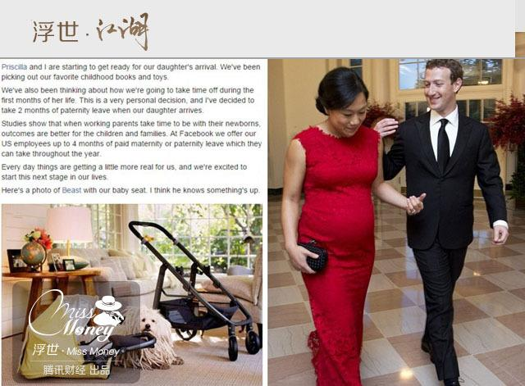

Slide 20
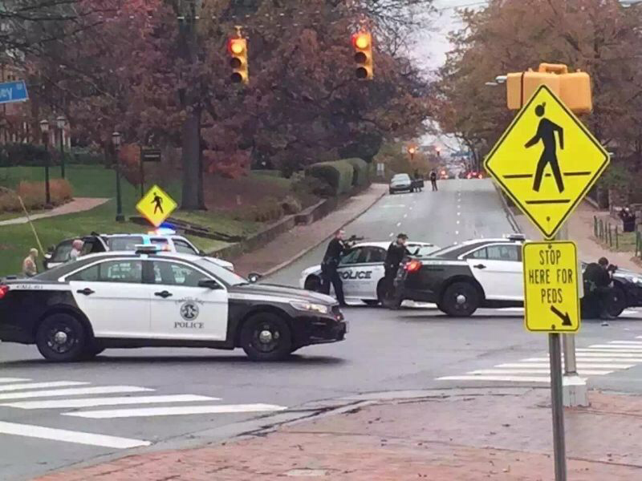
UNC-Chapel Hill, Dec 2, 2015

Slide 21
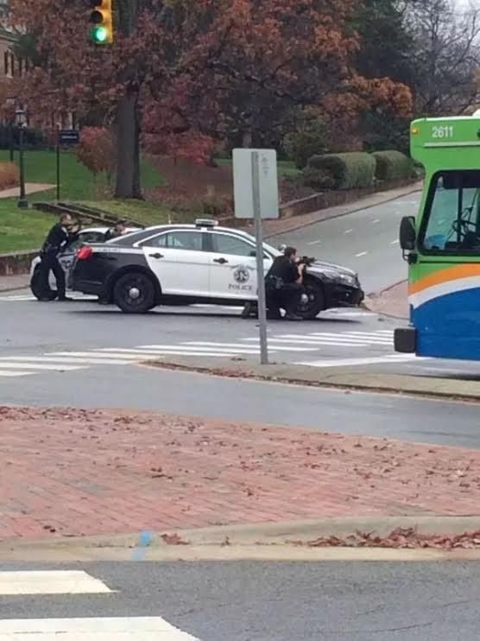

Slide 22
A true story 真实故事
1914 First World War. 第一次世界大战。
German vs British. 德国对英国。
Christmas eve. 圣诞夜。
Stille Nacht! Heilige Nacht!
Silent Night! Holy Night!
平安夜！圣善夜！

Slide 23
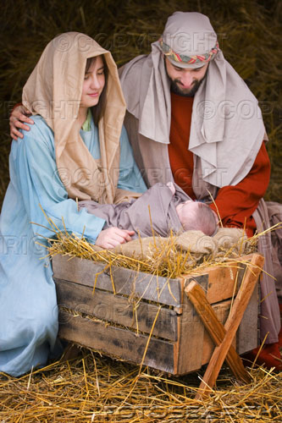
基督降生了
你们要看见一个婴孩，包着布，卧在马槽里，那就是记号了。 路 2:12

