Slide 1
胡熙来 打教会姐妹名一
薄涛

Slide 2
两个问题 Two Questions
黄力夫 Leaf Huang
北卡华人福音基督教会 CCMC

Slide 3
我将到大马色，正走的时候，约在晌午，忽然从天上发大光，四面照著我。 我就仆倒在地，听见有声音对我说：『扫罗！扫罗！你为什麽逼迫我？』 我回答说：『主啊，你是谁？』他说：『我就是你所逼迫的拿撒勒人耶稣。』 与我同行的人看见了那光，却没有听明那位对我说话的声音。 我说：『主啊，我当做什麽？』主说：『起来，进大马色去，在那里，要将所派你做的一切事告诉你。』 使徒行传 22：6-10

Slide 4
"About noon as I came near Damascus, suddenly a bright light from heaven flashed around me. I fell to the ground and heard a voice say to me, 'Saul! Saul! Why do you persecute me?' "'Who are you, Lord?' I asked. "'I am Jesus of Nazareth, whom you are persecuting,' he replied. My companions saw the light, but they did not understand the voice of him who was speaking to me. "'What shall I do, Lord?' I asked. "'Get up,' the Lord said, 'and go into Damascus. There you will be told all that you have been assigned to do.' Acts 22:6-10

Slide 5
保罗的见证 Paul’s Testimony
保罗归主是人类文明史中重要事件。
Paul’s conversion was one of the most important events in human civilization.
在使徒行传中出现过三次。Appeared in Acts three times.
这是第二次。This is the second time.

Slide 6
一个巨大的改变 A Huge Change
扫罗（保罗）原是一个青年才俊，前途无量。Saul (Paul) was a gifted young man with a great future.
他将到大马色（大马士革）。He was on his way to Damascus.
奇怪的事发生了。Strange thing happened.

Slide 7
大光照耀 Great Light Shined
超自然的事。Supernatural thing.
保罗没有中暑。Paul did not have a heat stroke.
保罗听见有声音对他说。Paul heard a voice speaking to him.

Slide 8
神圣的对话 A Holy Dialog
扫罗！扫罗！你为什麽逼迫我？
Saul！ Saul！ Why do you persecute me?
扫罗逼迫的是基督徒，不是耶稣。
The ones persecuted by Saul were Christians, not Jesus.
逼迫基督徒，就是逼迫耶稣。
Persecute Christian is to persecute Jesus.

Slide 9
第一个问题 The First Question
主啊，你是谁？Who are you, Lord?
我们每一个人遇见耶稣的情况都不同。
The occasion that we meet Jesus is different for everybody.
但我们都应该问同一个问题。
But we should ask the same question.

Slide 10
耶稣是谁 Who is Jesus?
我就是..拿撒勒人耶稣。I am Jesus of Nazareth.
拿但业对他说：「拿撒勒还能出什麽好的吗？」
"Nazareth! Can anything good come from there?" Nathanael asked.
被人藐视的地方。People looked down on this place.

Slide 11
耶稣 Jesus
一个犹太木匠。A Jewish carpenter.
没有受过正式教育。No formal education.
没有财富。No money.
没有地位。No high position.

Slide 12
生在马槽，死在十字架。Born in a manger, died on a cross.
生活潦倒。 Lived a poor life.
却有极大的权柄。But with mighty power.

Slide 13
医病赶鬼。Healing and casting out demons.
五饼二鱼使五千人吃饱，还剩12篮。
Fed 5,000 with 5 loaves and 2 fish with 12 baskets of leftover.
拿破仑的感叹。 Napoleon’s sad sigh.

Slide 14
惟有基督在我们还作罪人的时候为我们死，神的爱就在此向我们显明了。
But God demonstrates his own love for us in this: While we were still sinners, Christ died for us. Rom 罗 5：8

Slide 15
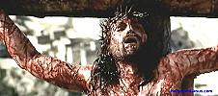
父啊！赦免他们；因为他们所做的，他们不晓得。 路 Luke 23:34
"Father, forgive them, for they do not know what they are doing."

Slide 16
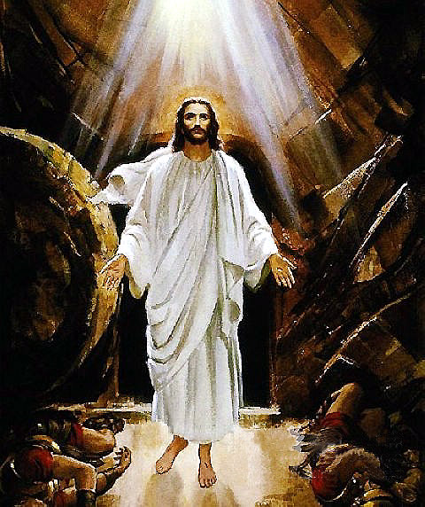
死里复活。Resurrection.
可信吗？Believable?
多人看见。Many had seen.
如同五饼二鱼的神迹一样。Just like the miracle of 5 loaves & 2 fish.

Slide 17
保罗相信了Paul believed
犹太人等候弥赛亚（救主）已经很久了。Jews had been waiting for the Messiah for a long time.
保罗绝不是第一次听见耶稣。Must not be the first time for Paul to hear about Jesus.
但这次亲身遇见。But this time he met Him in person.

Slide 18
耶稣邀请我们 Jesus invites us
耶稣说：「你们来看。」“Come,” Jesus replied, “and you will see.”约 John 1:39
看什么？What to see?
神的荣美。Glory and beauty of God.
我们遇见弥赛亚了！We have found the Messiah！ 约 John 1:41
您呢？How about you?

Slide 19
第二个问题 The second question
主啊，我当做什麽？What shall I do, Lord?
每一个基督徒都应该问的问题。
Every Christian should ask this Q.

Slide 20
把人生的主权交给耶稣。Give Jesus the authority of our lives – Lordship.
不管是眼前的，还是未来的。No matter it is for now or future.
主给了保罗一个立即的指示。Lord gave Paul an immediate instruction.
起来，进大马色去。 Get up，go into Damascus.

Slide 21
我在考虑退休。I am contemplating retirement.
不知在何处事奉主。Don’t know where shall we serve the Lord.
不要惧怕，只管站住。 Do not be afraid, stand firm. 出 Exo 14:13
所以我们要留在这里？So, we should stay here?
起来！向南走。Get up and go south. 徒 Acts 8:26

Slide 22
主的旨意永远最好。Lord’s will is always the best.
“被动”并不坏。Being passive is not bad.
我总不撇下你，也不丢弃你。Never will I leave you; never will I forsake you. 来 Heb 13:5

Slide 23
为主做点什么 Anything for the Lord?
因为你要将所看见的，所听见的，对著万人为他作见证。You will be his witness to all people of what you have seen and heard. 徒 Acts 22:15
亚基帕王啊，我故此没有违背那从天上来的异象。So then, King Agrippa, I was not disobedient to the vision from heaven. 徒 Acts 26:19

Slide 24
信他的人，不被定罪；不信的人，罪已经定了，因为他不信神独生子的名。
Whoever believes in him is not condemned, but whoever does not believe stands condemned already because they have not believed in the name of God‘s one and only Son. 约 John 3:18
我们真相信这经文吗？Do we really believe this verse?

Slide 25
那美好的仗我已经打过了，当跑的路我已经跑尽了，所信的道我已经守住了。 I have fought the good fight, I have finished the race, I have kept the faith. 提后II Tim 4:7
交账的时候快到了。Time of reporting to the Boss is near.
无怨无悔，坦然见主。No grudges, no regrets. Peacefully facing Lord.

