Slide 1
Mark 12: 28-34
YOUR COMMAND IS
MYOUR DESIRE

Slide 2
Message of Mk 12: 28-34:
Only authentic faith in Jesus the Christ brings us into God’s Kingdom.
唯独对耶稣，也就是基督，有实质的信心方能进入上帝的国度。

Slide 3
We are not the final judge of the good command; rather, we are to put in all the effort to align our personal desire to what GOOD has been commanded to us.

Slide 4
Love the Lord your God with all your heart and with all your soul and with all your mind and with all your strength.
Love your neighbor as yourself.

Slide 5
A call to a “WHOLE PERSON” type of obedience to God; a call to a “WHOLE PERSON” type of worship of God

Slide 6
Heart: Conviction
Soul: Vitality of Life
Mind: Thinking
Strength: Physical ability
(possessions included)

Slide 7
Mk 12: 41-44 …Many rich people threw in large amounts. But a poor widow came and put in two very small copper coins, worth only a few cents. Calling his disciples to him, Jesus said, “Truly I tell you, this poor widow has put more into the treasury than all the others. They all gave out of their wealth; but she, out of her poverty, put in everything—all she had to live on.”

Slide 8
What occupies your mind in your down time?
Where does your mind wander off to?

Slide 9
Wholly devoted, I immerse myself in You, baptize me in Your love, cos’ drowning in the thought of You floods my soul, I'm taken by the things You do, it doesn't matter what I lose, I'm Yours, You consume me, You consume me, like a burning flame running through my veins; You consume me, moving through me, anytime, anyplace, You invade my space.
~ D.C. Talk’s Consume Me

Slide 10
http://hyperboleandahalf.blogspot.com/2010/10/god-of-cake.html

Slide 11
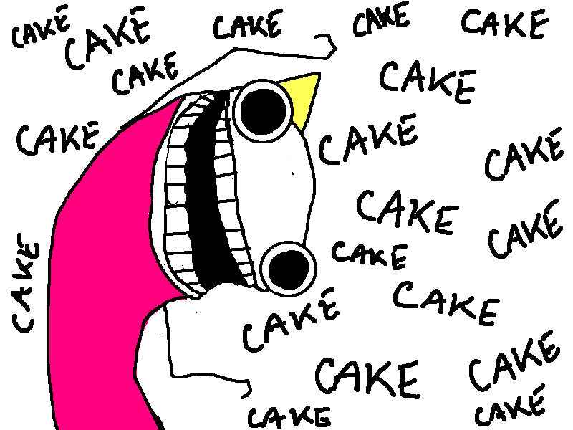
http://hyperboleandahalf.blogspot.com/2010/10/god-of-cake.html

Slide 12
http://hyperboleandahalf.blogspot.com/2010/10/god-of-cake.html

Slide 13
In January of 1930 Frank Laubach began to cultivate the habit of turning his mind to Christ for one second out of every minute.

Slide 14
1 Cor 10: 31 … So whether you eat or drink or whatever you do, do it all for the glory of God.

Slide 15
Jesus said, “The most important (commandment) is this: ‘Hear, O Israel: The Lord our God, the Lord is one. Love the Lord your God with all your heart and with all your soul and with all your mind and with all your strength.’” 第 一 要 紧 的 就 是 说 ： 以 色 列 阿 ， 你 要 听 ， 主 ─ 我 们 神 是 独 一 的 主 。你 要 尽 心 、 尽 性 、 尽 意 、 尽 力 爱 主 ─ 你 的 神 。

Slide 16
“As yourself” refers to the INTENSITY and DEVOTION-DEDICATION-COMMITMENT we give to ourselves as much as it is the MANNER by which we love ourselves.

Slide 17
If your heart is pinched over a stained shirt, how much more must you be in agony over the many lives which are shattered, even perishing in sin?

Slide 18
To me the question isn't how much I should give away, but how much I should keep. I see my money as belonging to whoever needs it most: every dollar I spend is a dollar out of the hands of someone who needs it more than me. I’ve always felt that way.
~Julia Wise

Slide 19
Wise knowledge (and moral behavior) brings us close to the Kingdom but not into the Kingdom i.e., Only authentic faith in Jesus the Christ brings us into God’s Kingdom.

Slide 20
Jesus the Christ does not expect us to be of sinless perfection, but he does expect us to grow, mature, and progressively transform into his likeness.

Slide 21
Jn 15: 5-6 …I am the vine; you are the branches. If you remain in me and I in you, you will bear much fruit; apart from me you can do nothing. If you do not remain in me, you are like a branch that is thrown away and withers; such branches are picked up, thrown into the fire and burned.

Slide 22
Birthed out of a life touched and formed by the Gospel.

Slide 23
The commandments will not be taken on as rules to be obeyed out of respect for an authority, good as that is. Instead, the commandments will be taken on as desires of the heart to be lived out of the love for the Lover of our souls.

