Slide 1
如鹰展翅上腾
Soar on Wings Like Eagles

Slide 2
你岂不曾知道吗？你岂不曾听见吗？永在的神耶和华，创造地极的主，并不疲乏，也不困倦；他的智慧无法测度。疲乏的，他赐能力；软弱的，他加力量。就是少年人也要疲乏困倦；强壮的也必全然跌倒。但那等候耶和华的必从新得力。他们必如鹰展翅上腾；他们奔跑却不困倦，行走却不疲乏。（赛四十：28-31）

Slide 3
Have you not known? Have you not heard? The Lord is the everlasting God, the Creator of the ends of the earth. He does not faint or grow weary; his understanding is unsearchable. He gives power to the faint, and strengthens the powerless. Even youths will faint and be weary, and the young will fall exhausted; but those who wait for the Lord shall renew their strength, they shall mount up with wings like eagles, they shall run and not be weary, they shall walk and not faint. (Isaiah 40:28-31 NRSV)

Slide 4
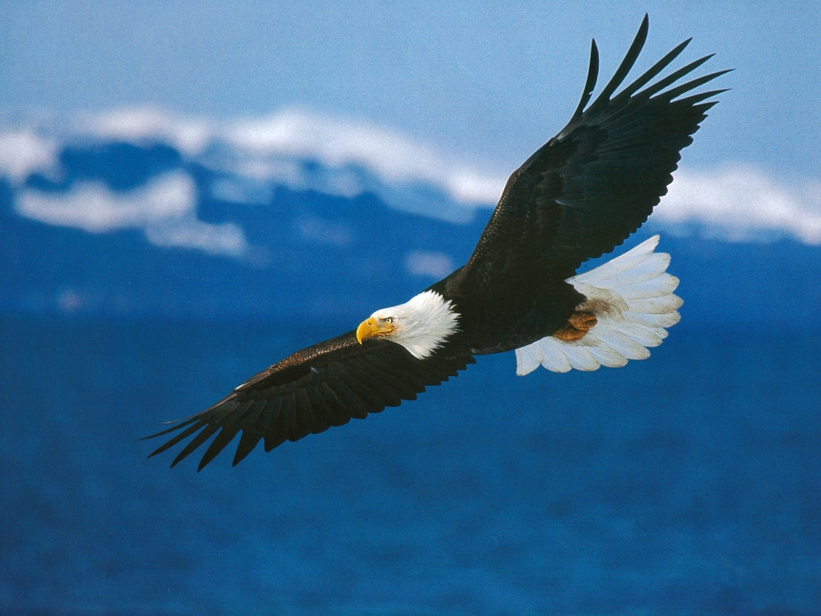

Slide 5
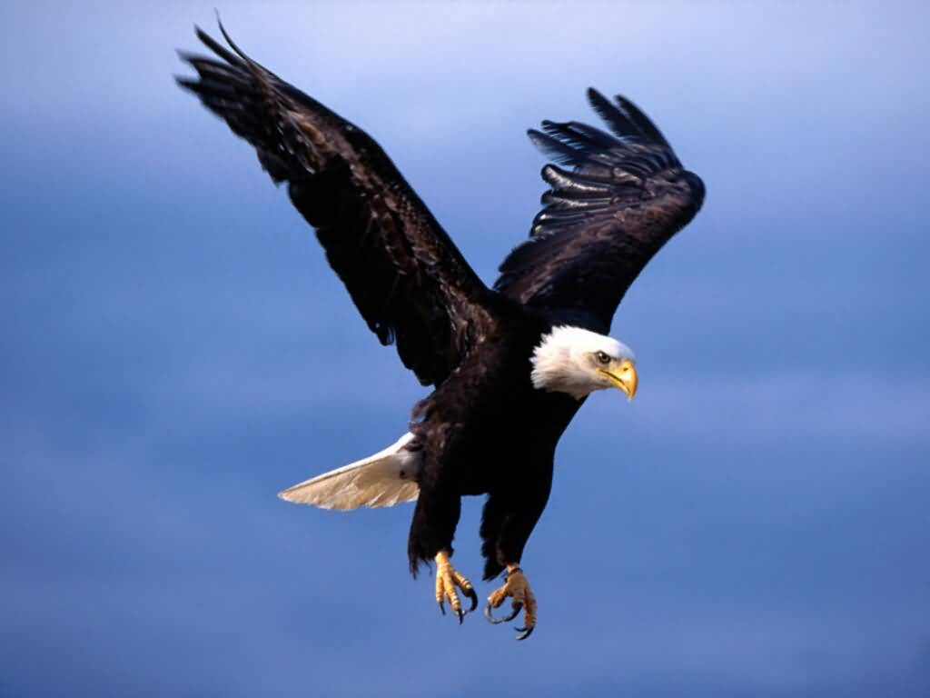

Slide 6
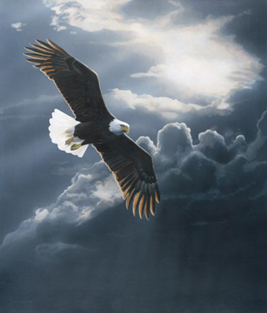

Slide 7
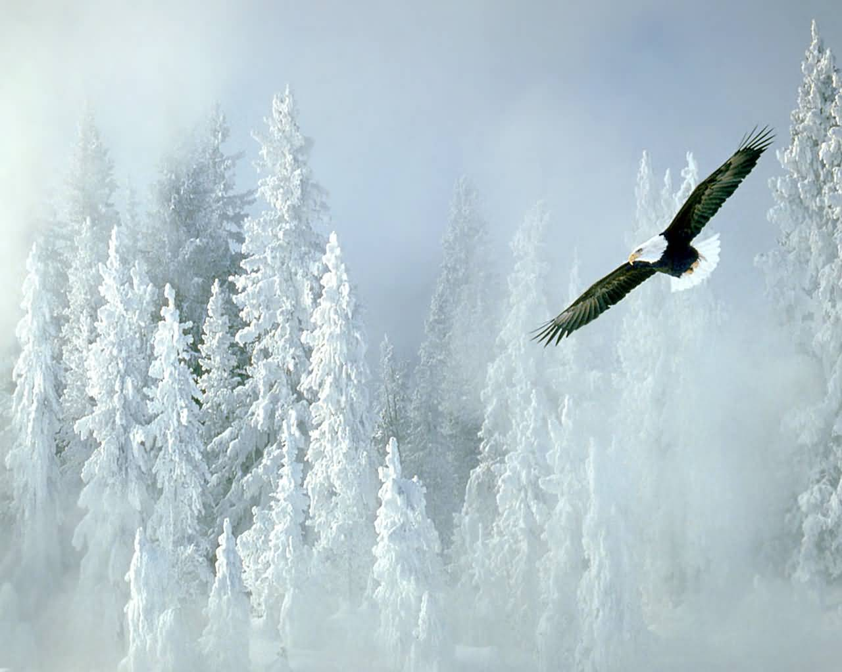

Slide 8
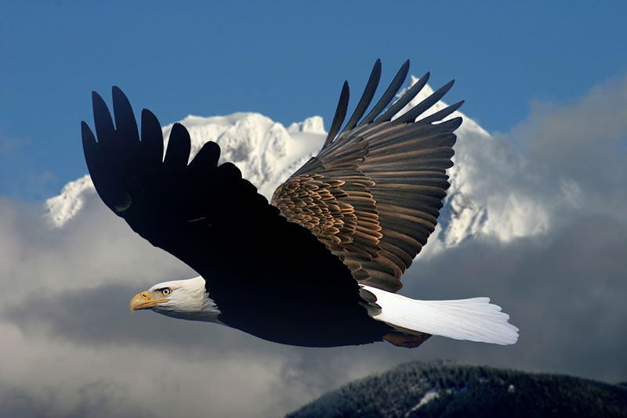

Slide 9
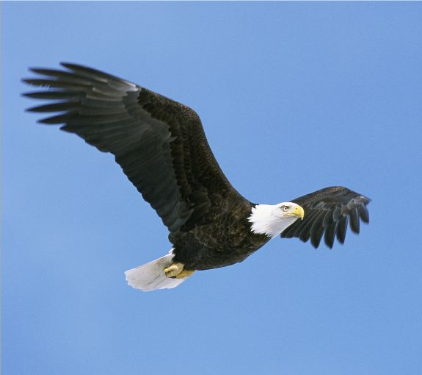

Slide 10
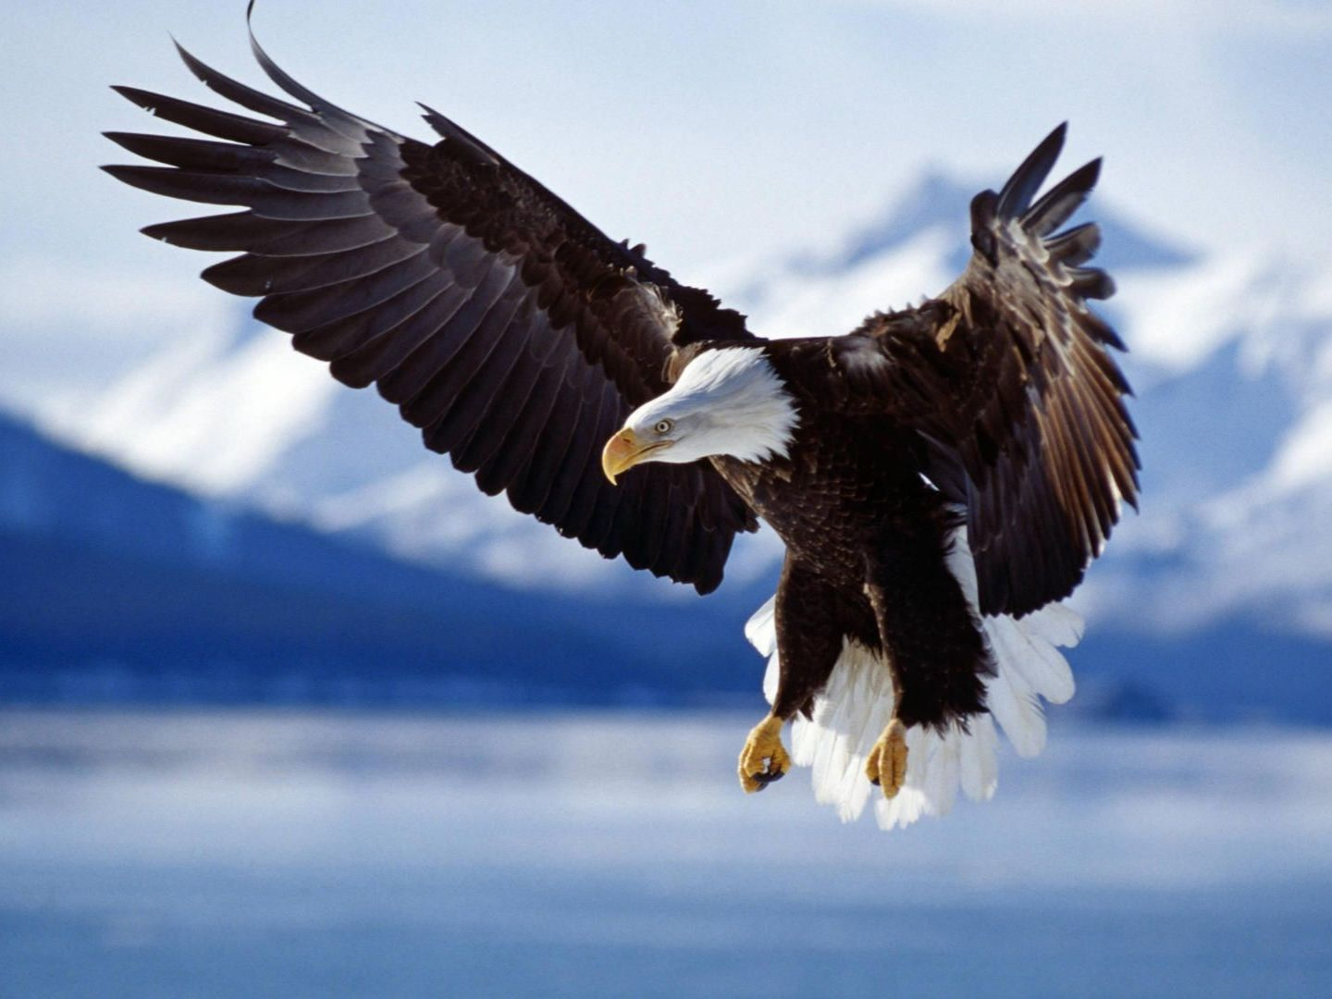

Slide 11
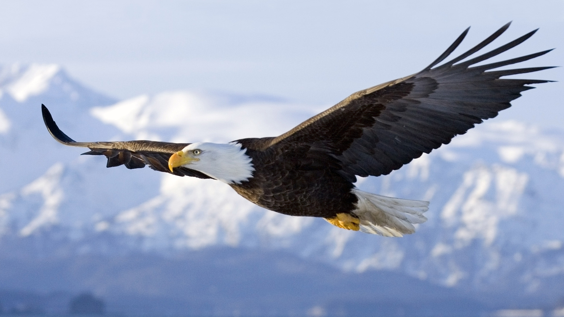

Slide 12
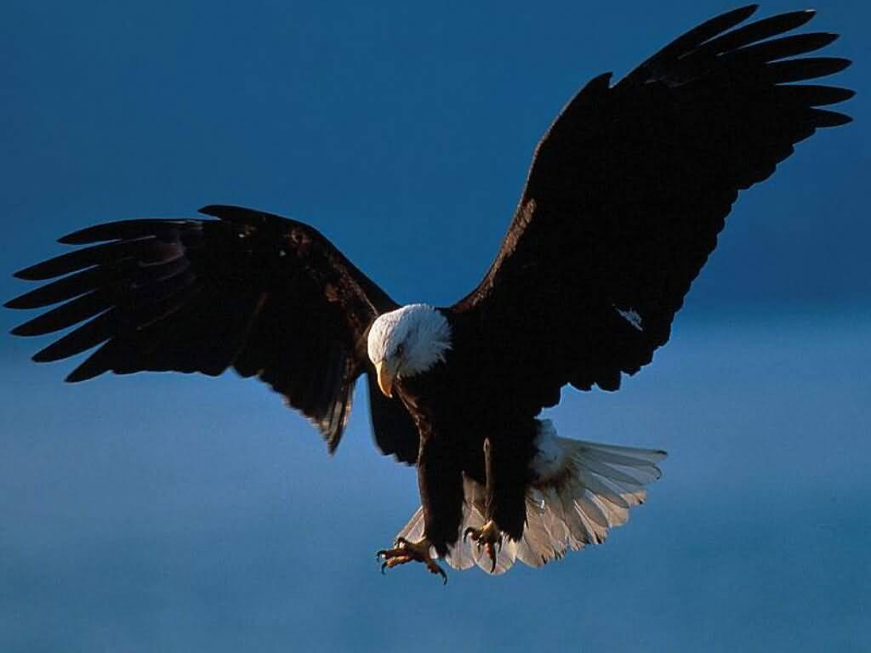

Slide 13
